Slide 1


FRUIT FLY ERADICATION Checking Fruit

Slide 2
Fruit Fly

Slide 3
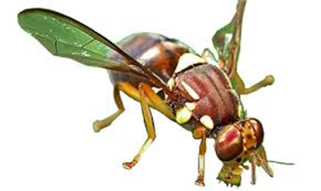
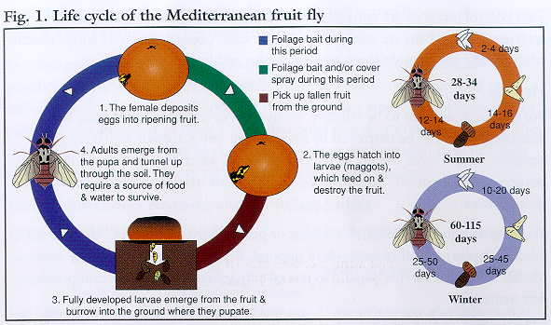
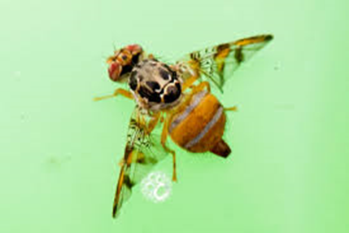
Fruit Fly
Q Fly
Queensland Fruit Fly (Q-Fly)
Eastern States
Mediterranean Fruit Fly (Med-Fly)
Western Australia
Exotic Fruit Fly
Med Fly

Slide 4
Fruit Fly
Fruit fly are most active after heavy rain or periods of high humidity
Flies gain sexual maturity within 9-10 days and typically live for 2-3 months
Female flies pierce the skin of both ripening and mature fruit to lay their eggs beneath the surface.
Females may lay up to 3000 eggs in their lifespan.
Larval stage is dependent on temperature and moisture.

Slide 5
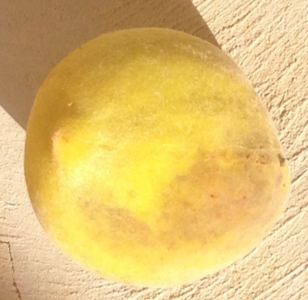
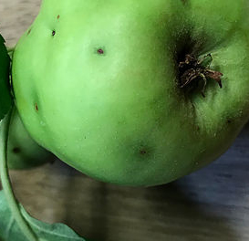

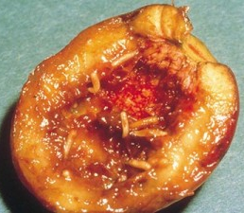
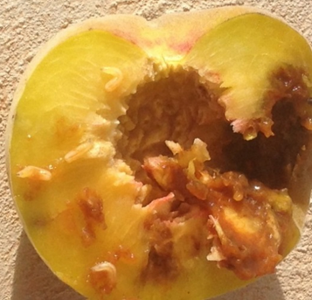
Technical check (Tec Check)
Tec Check
Check ripe and ripening fruit looking for signs of damage
All bruised, distorted or rotting
Be careful removing fruit off trees
Shack the tree for overripe fruit
Cut up fruit and inspect for maggots
Call inspector immediately if anything found
technical check

Slide 6

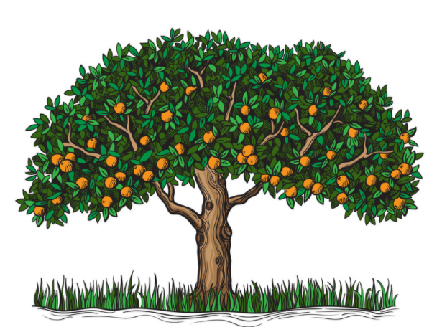
Hover above the tree humid
Feed on the south damp (fungus, mould)
Lay eggs on warm north side

Slide 7
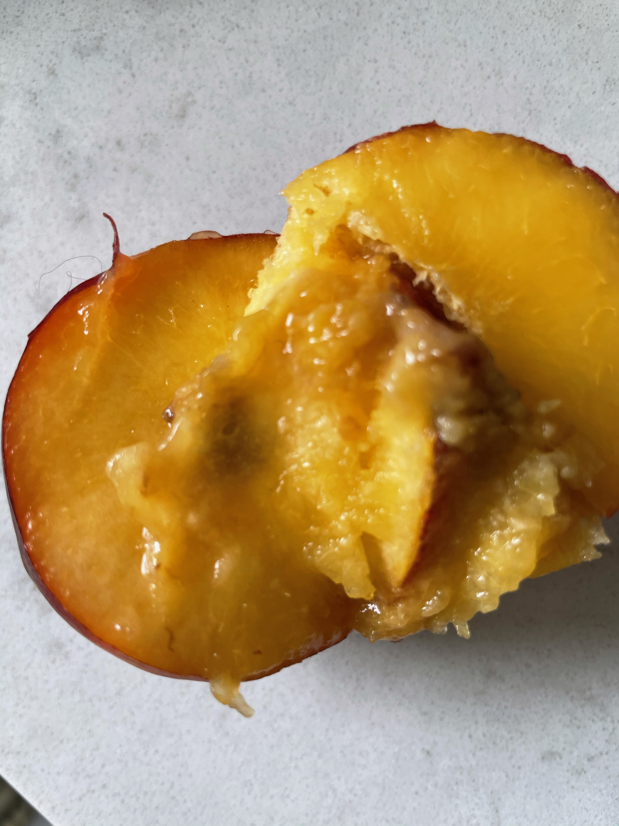
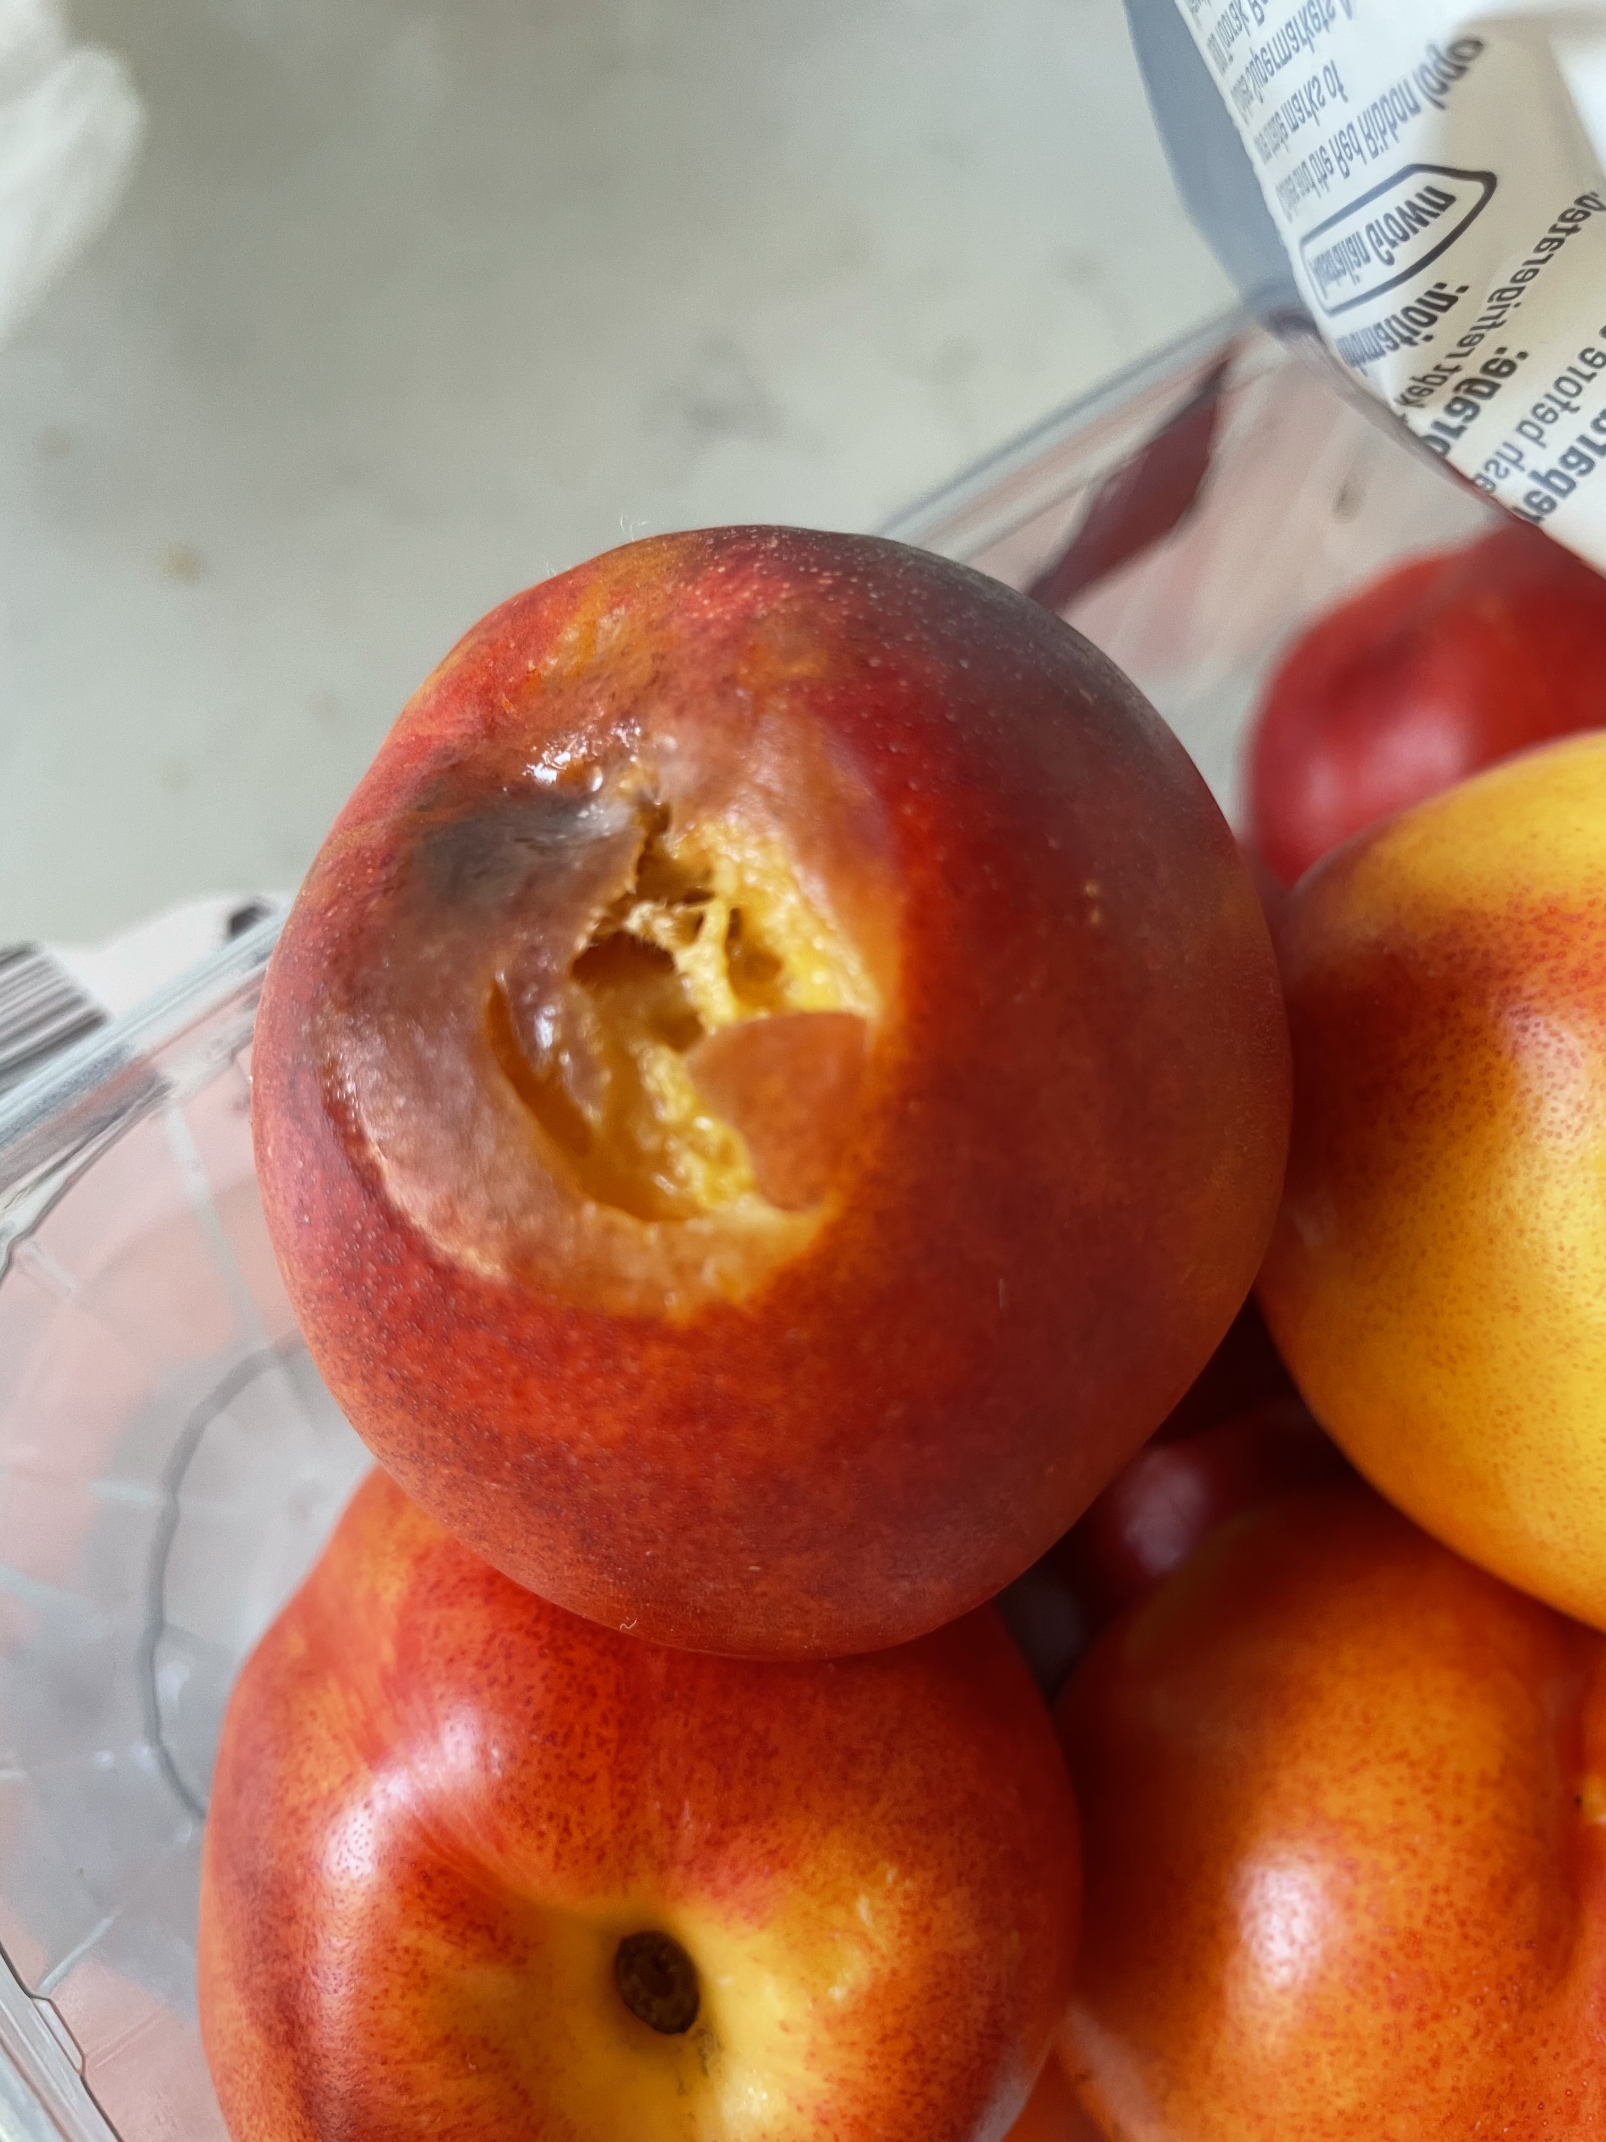
Fruit Fly or Not!

Slide 8
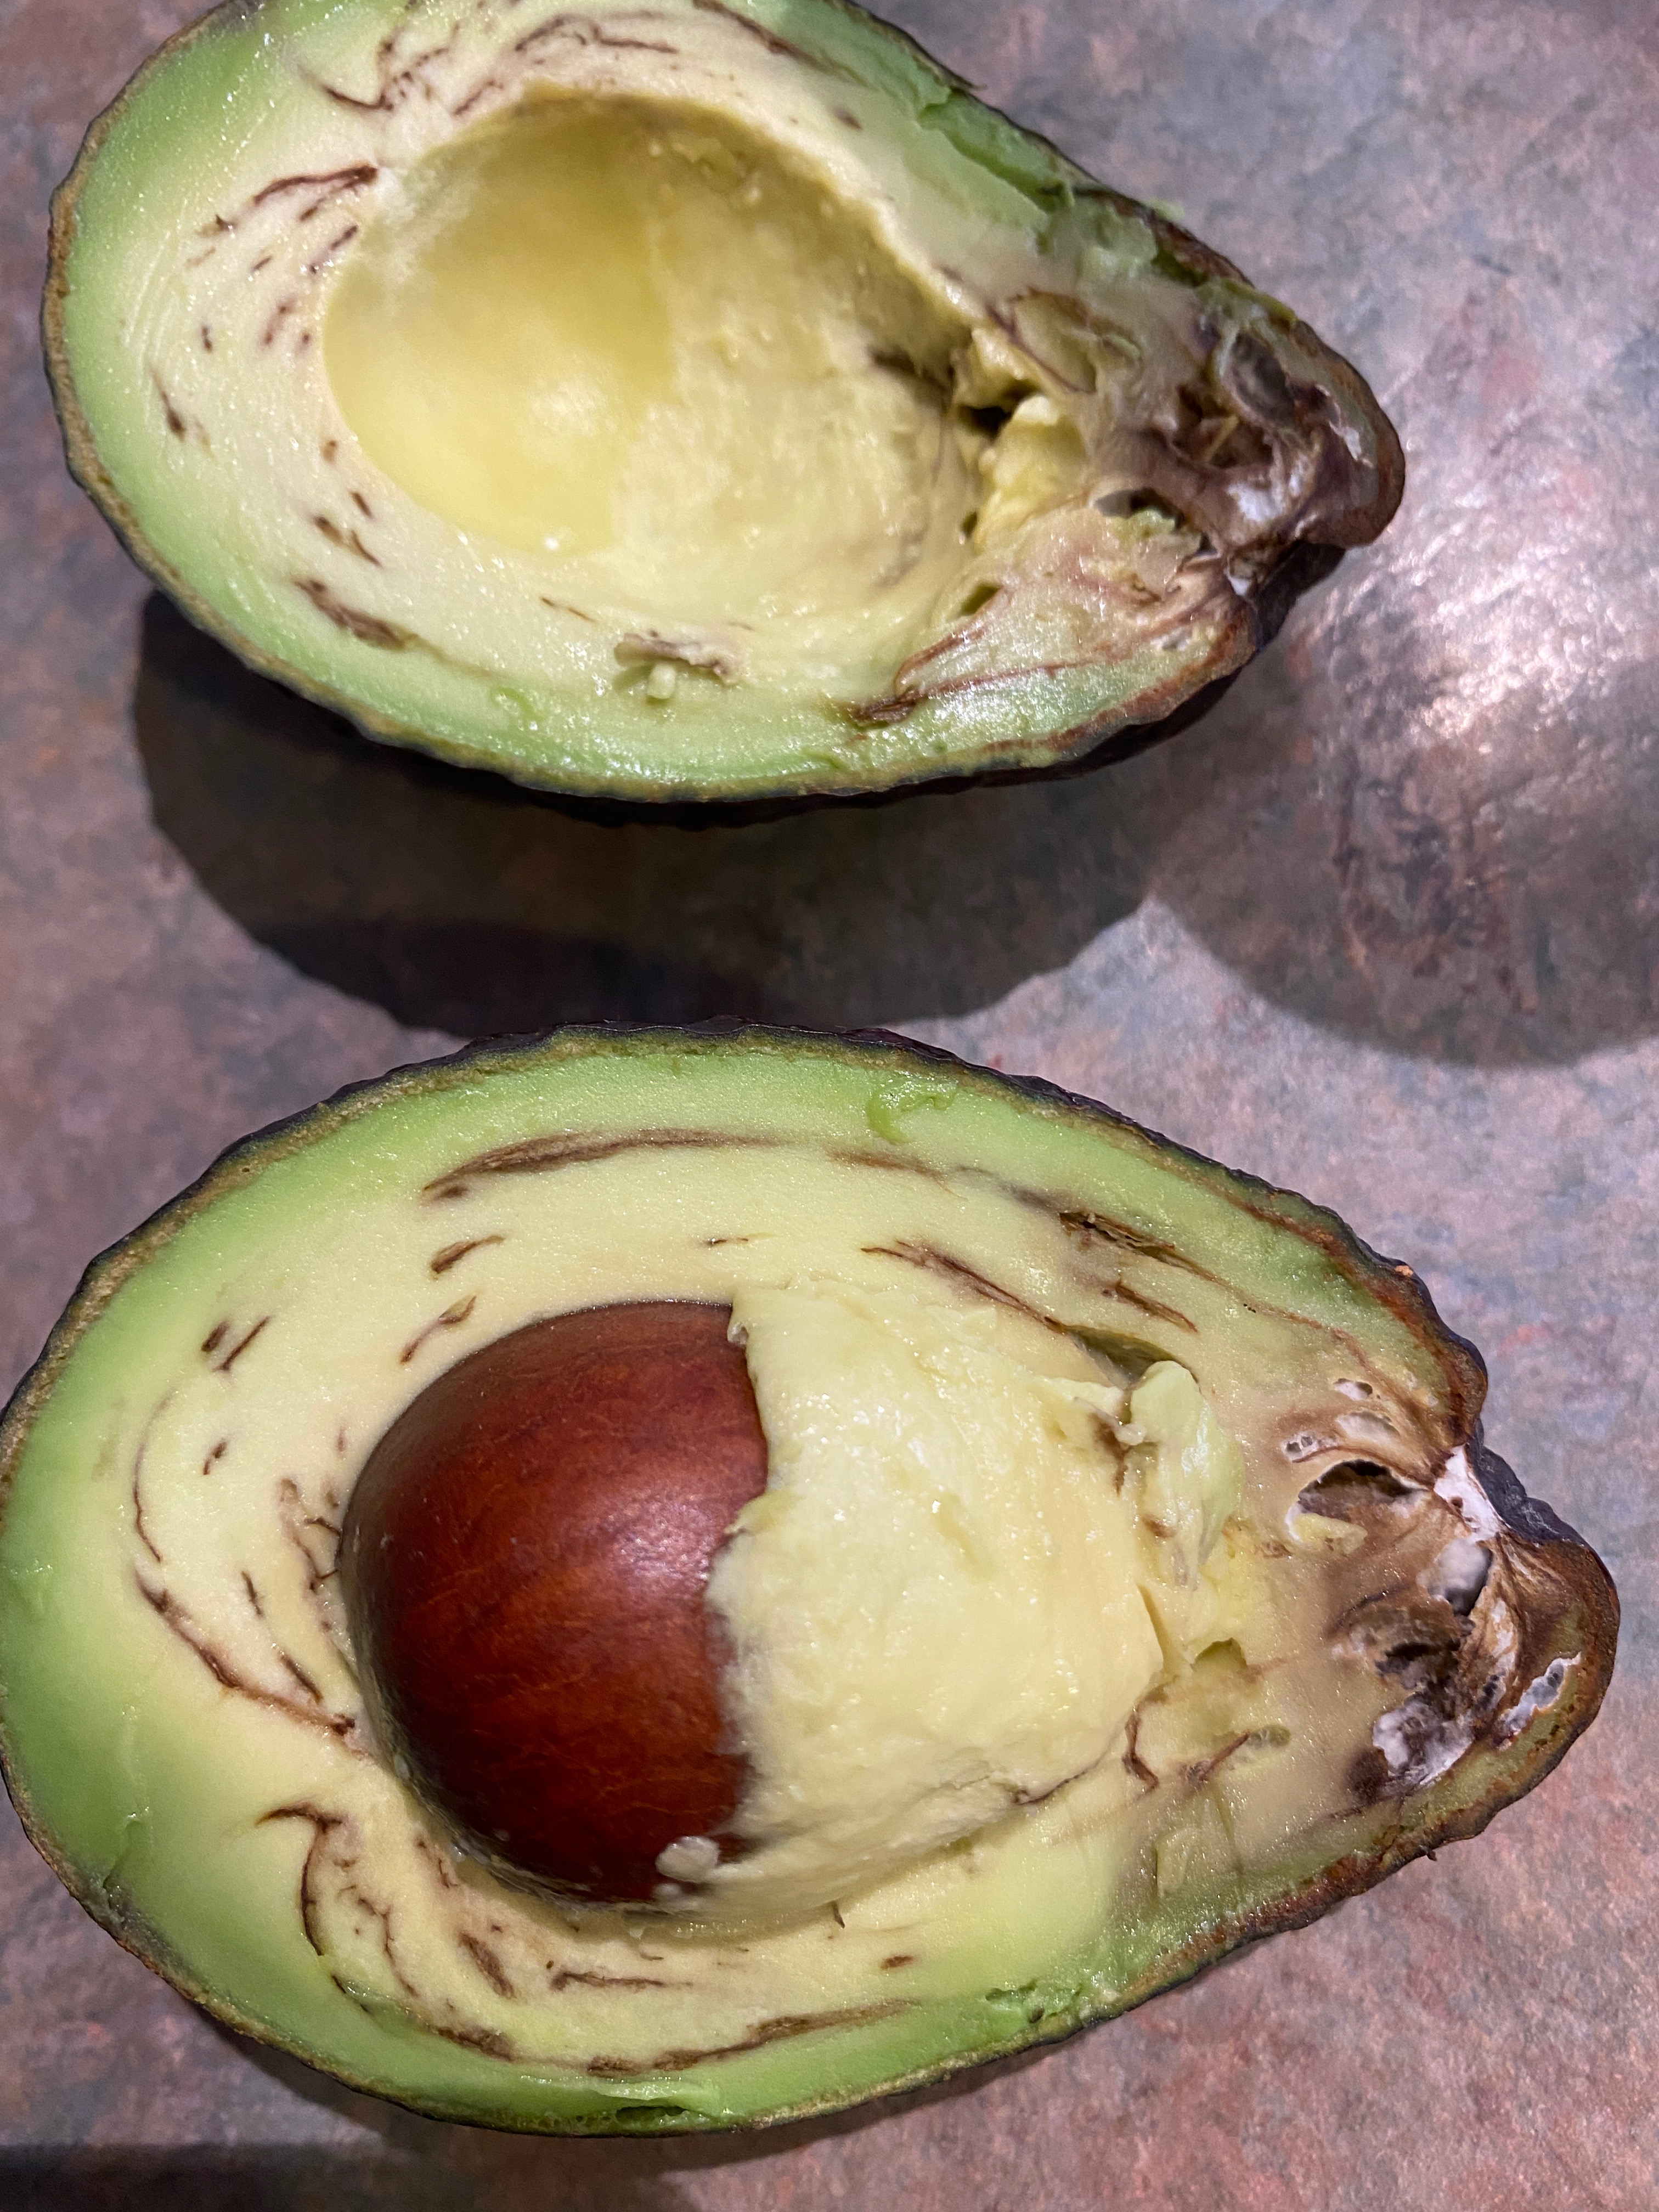
Fruit Fly or Not!

Slide 9
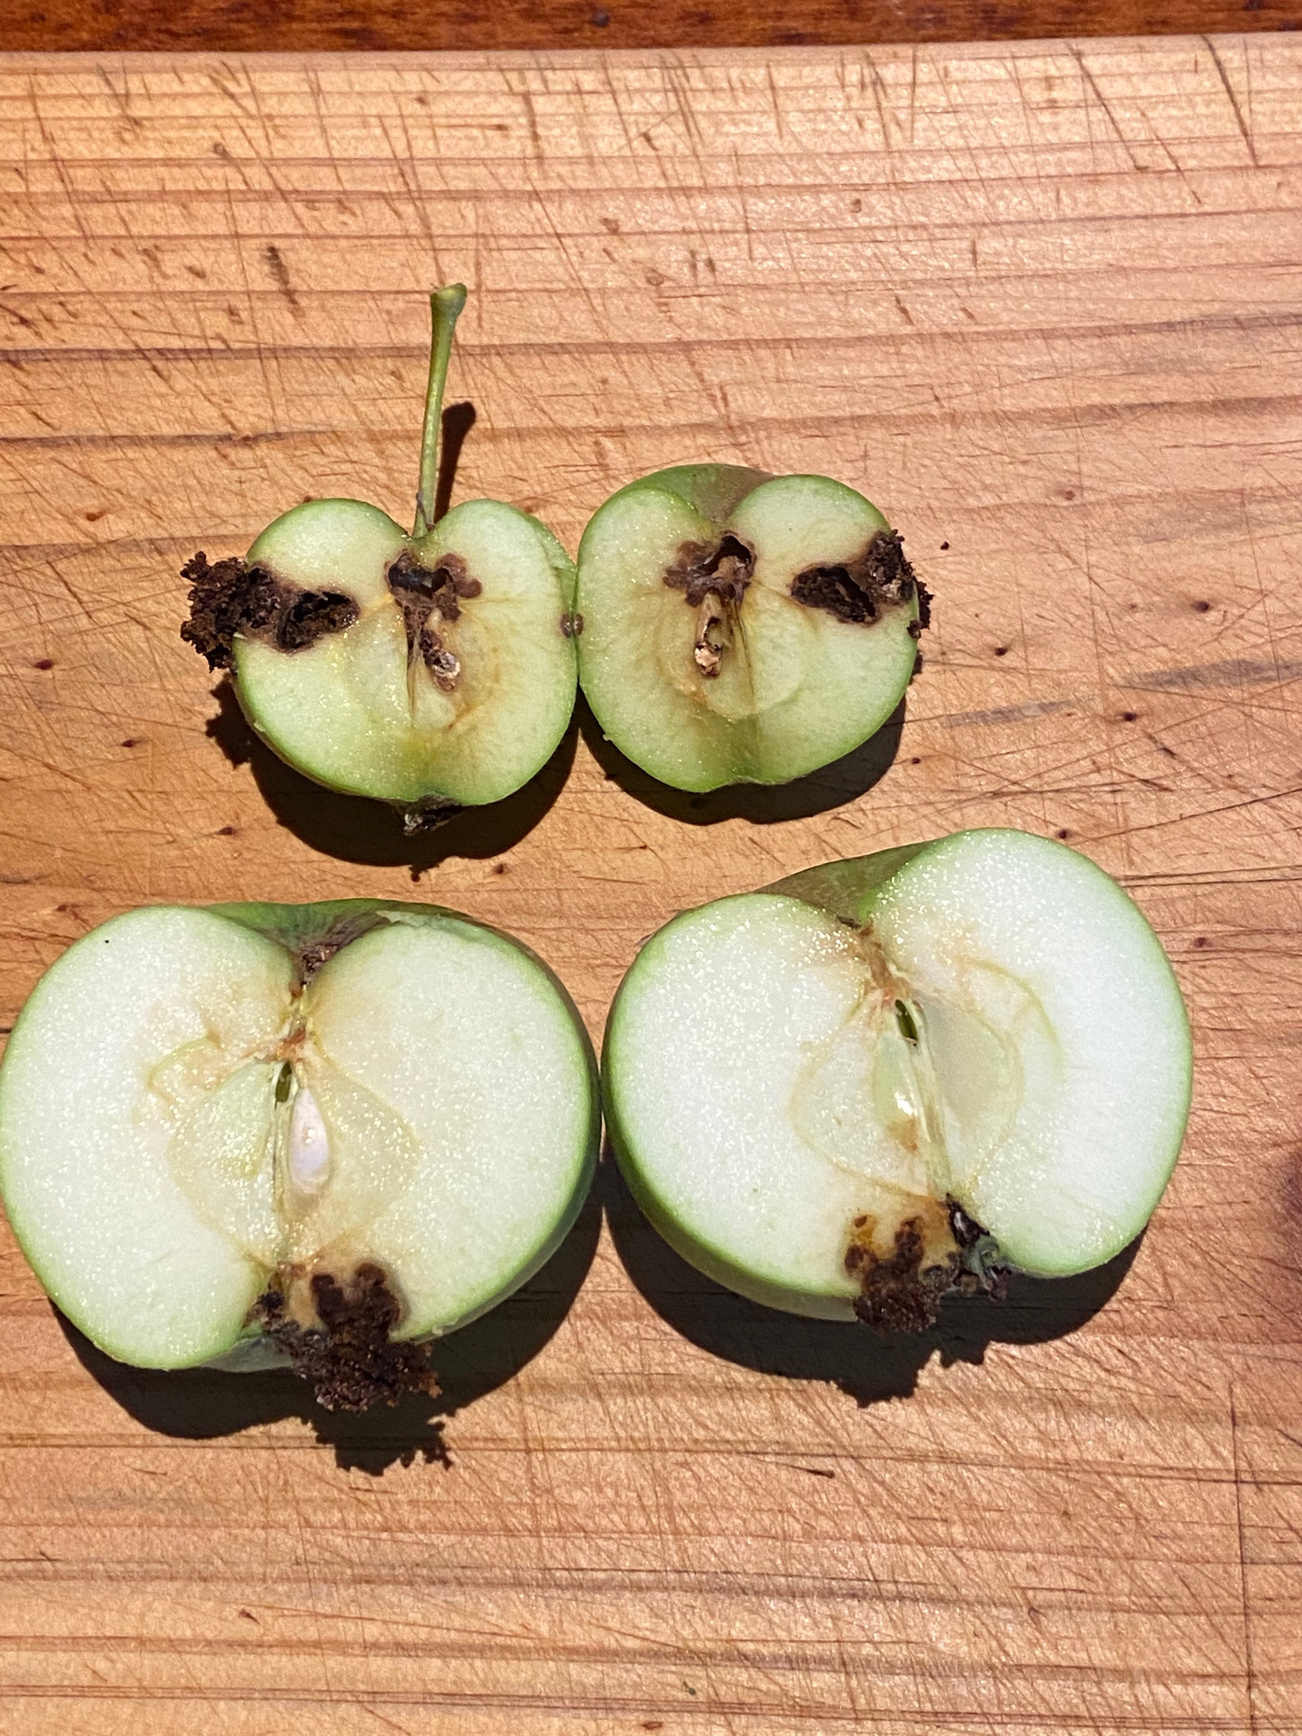
Fruit Fly or Not!

Slide 10
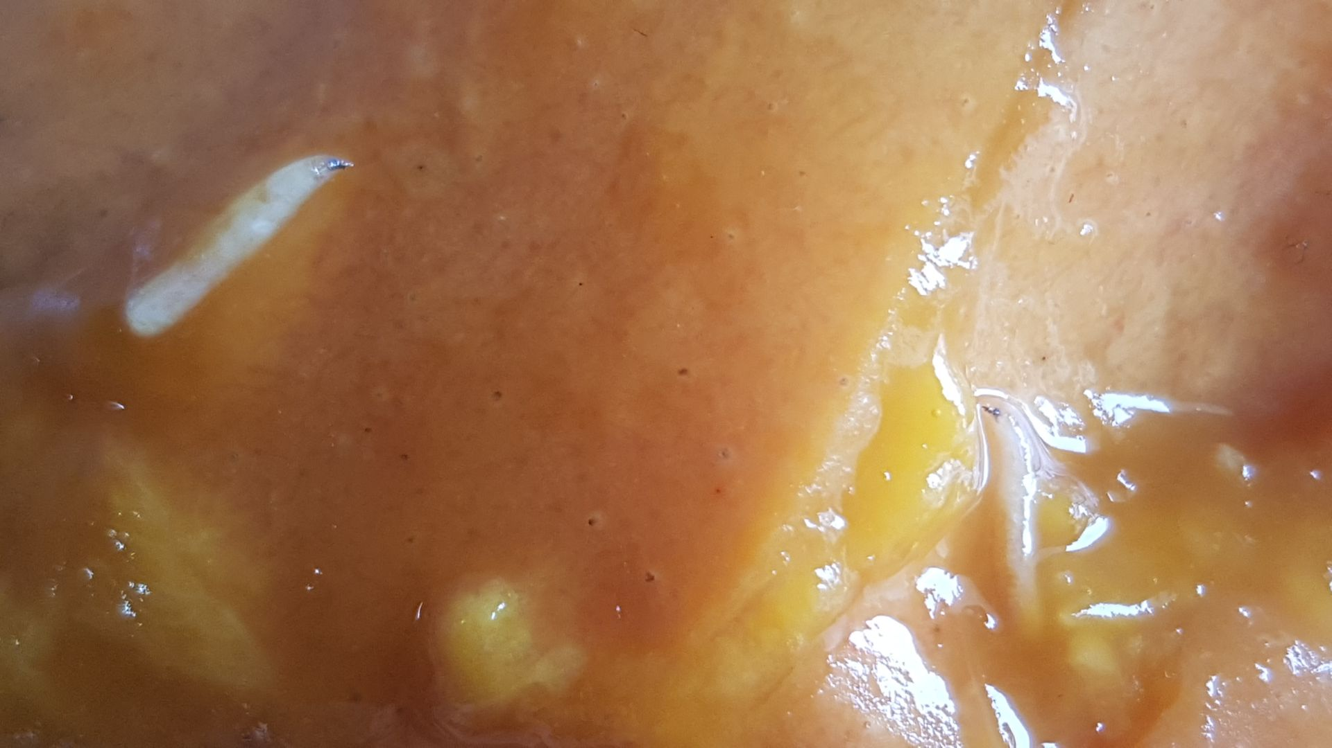
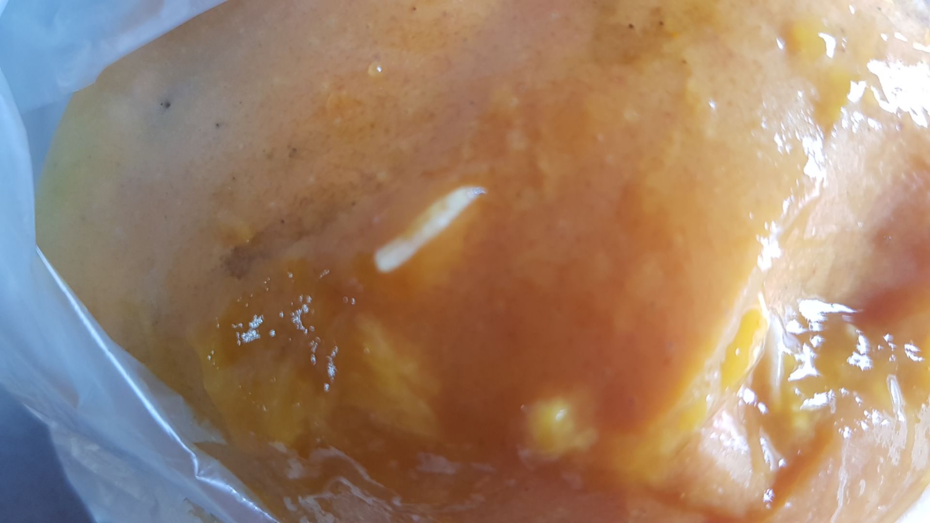
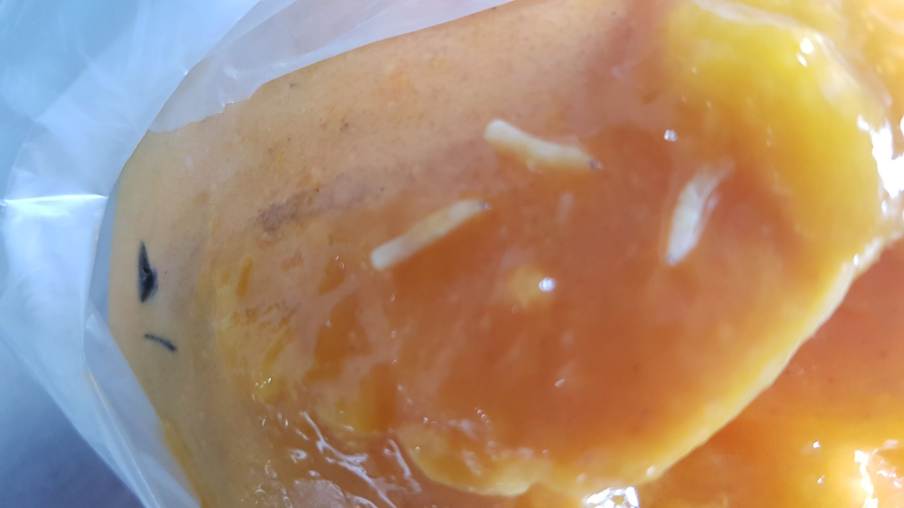
Fruit Fly or Not!

Slide 11
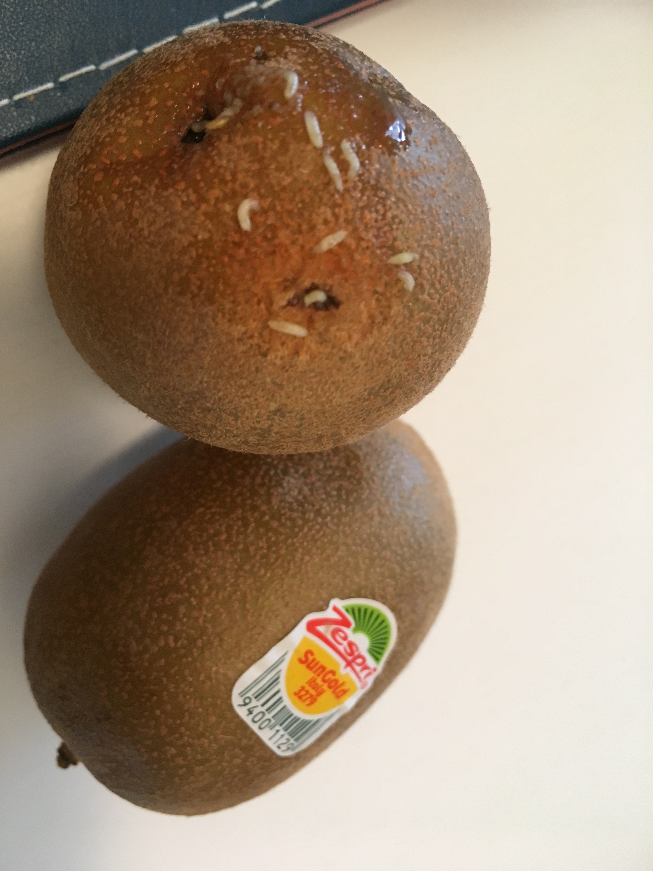
Fruit Fly or Not!

Slide 12
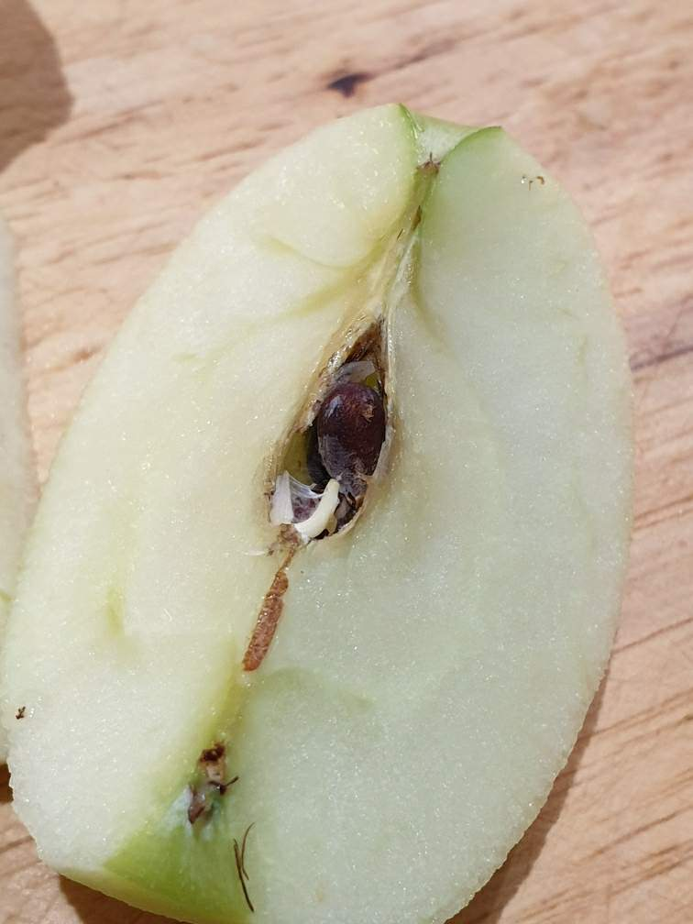
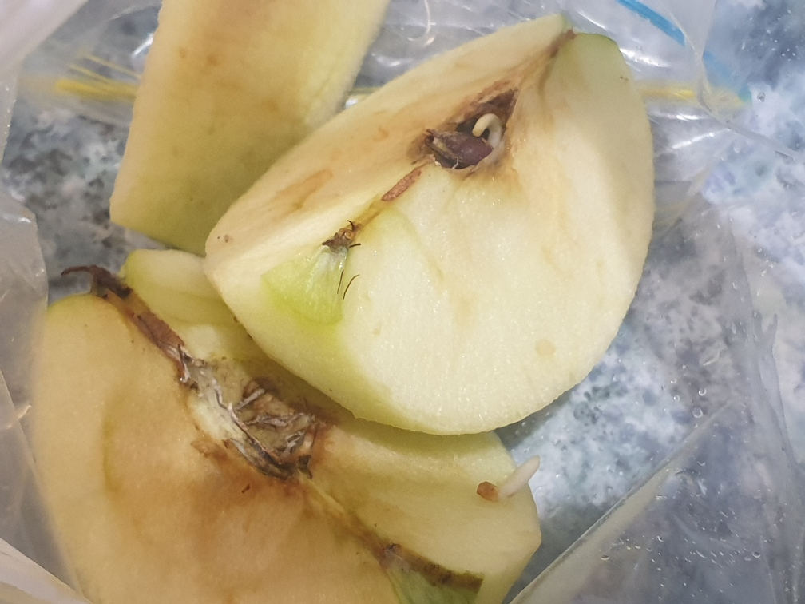
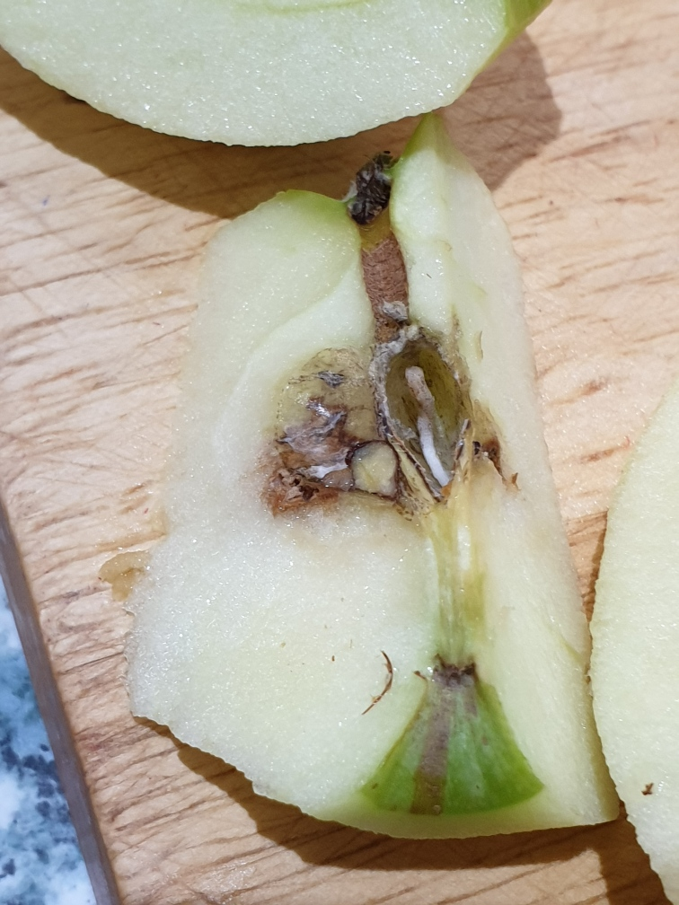
Fruit Fly or Not!

Slide 13
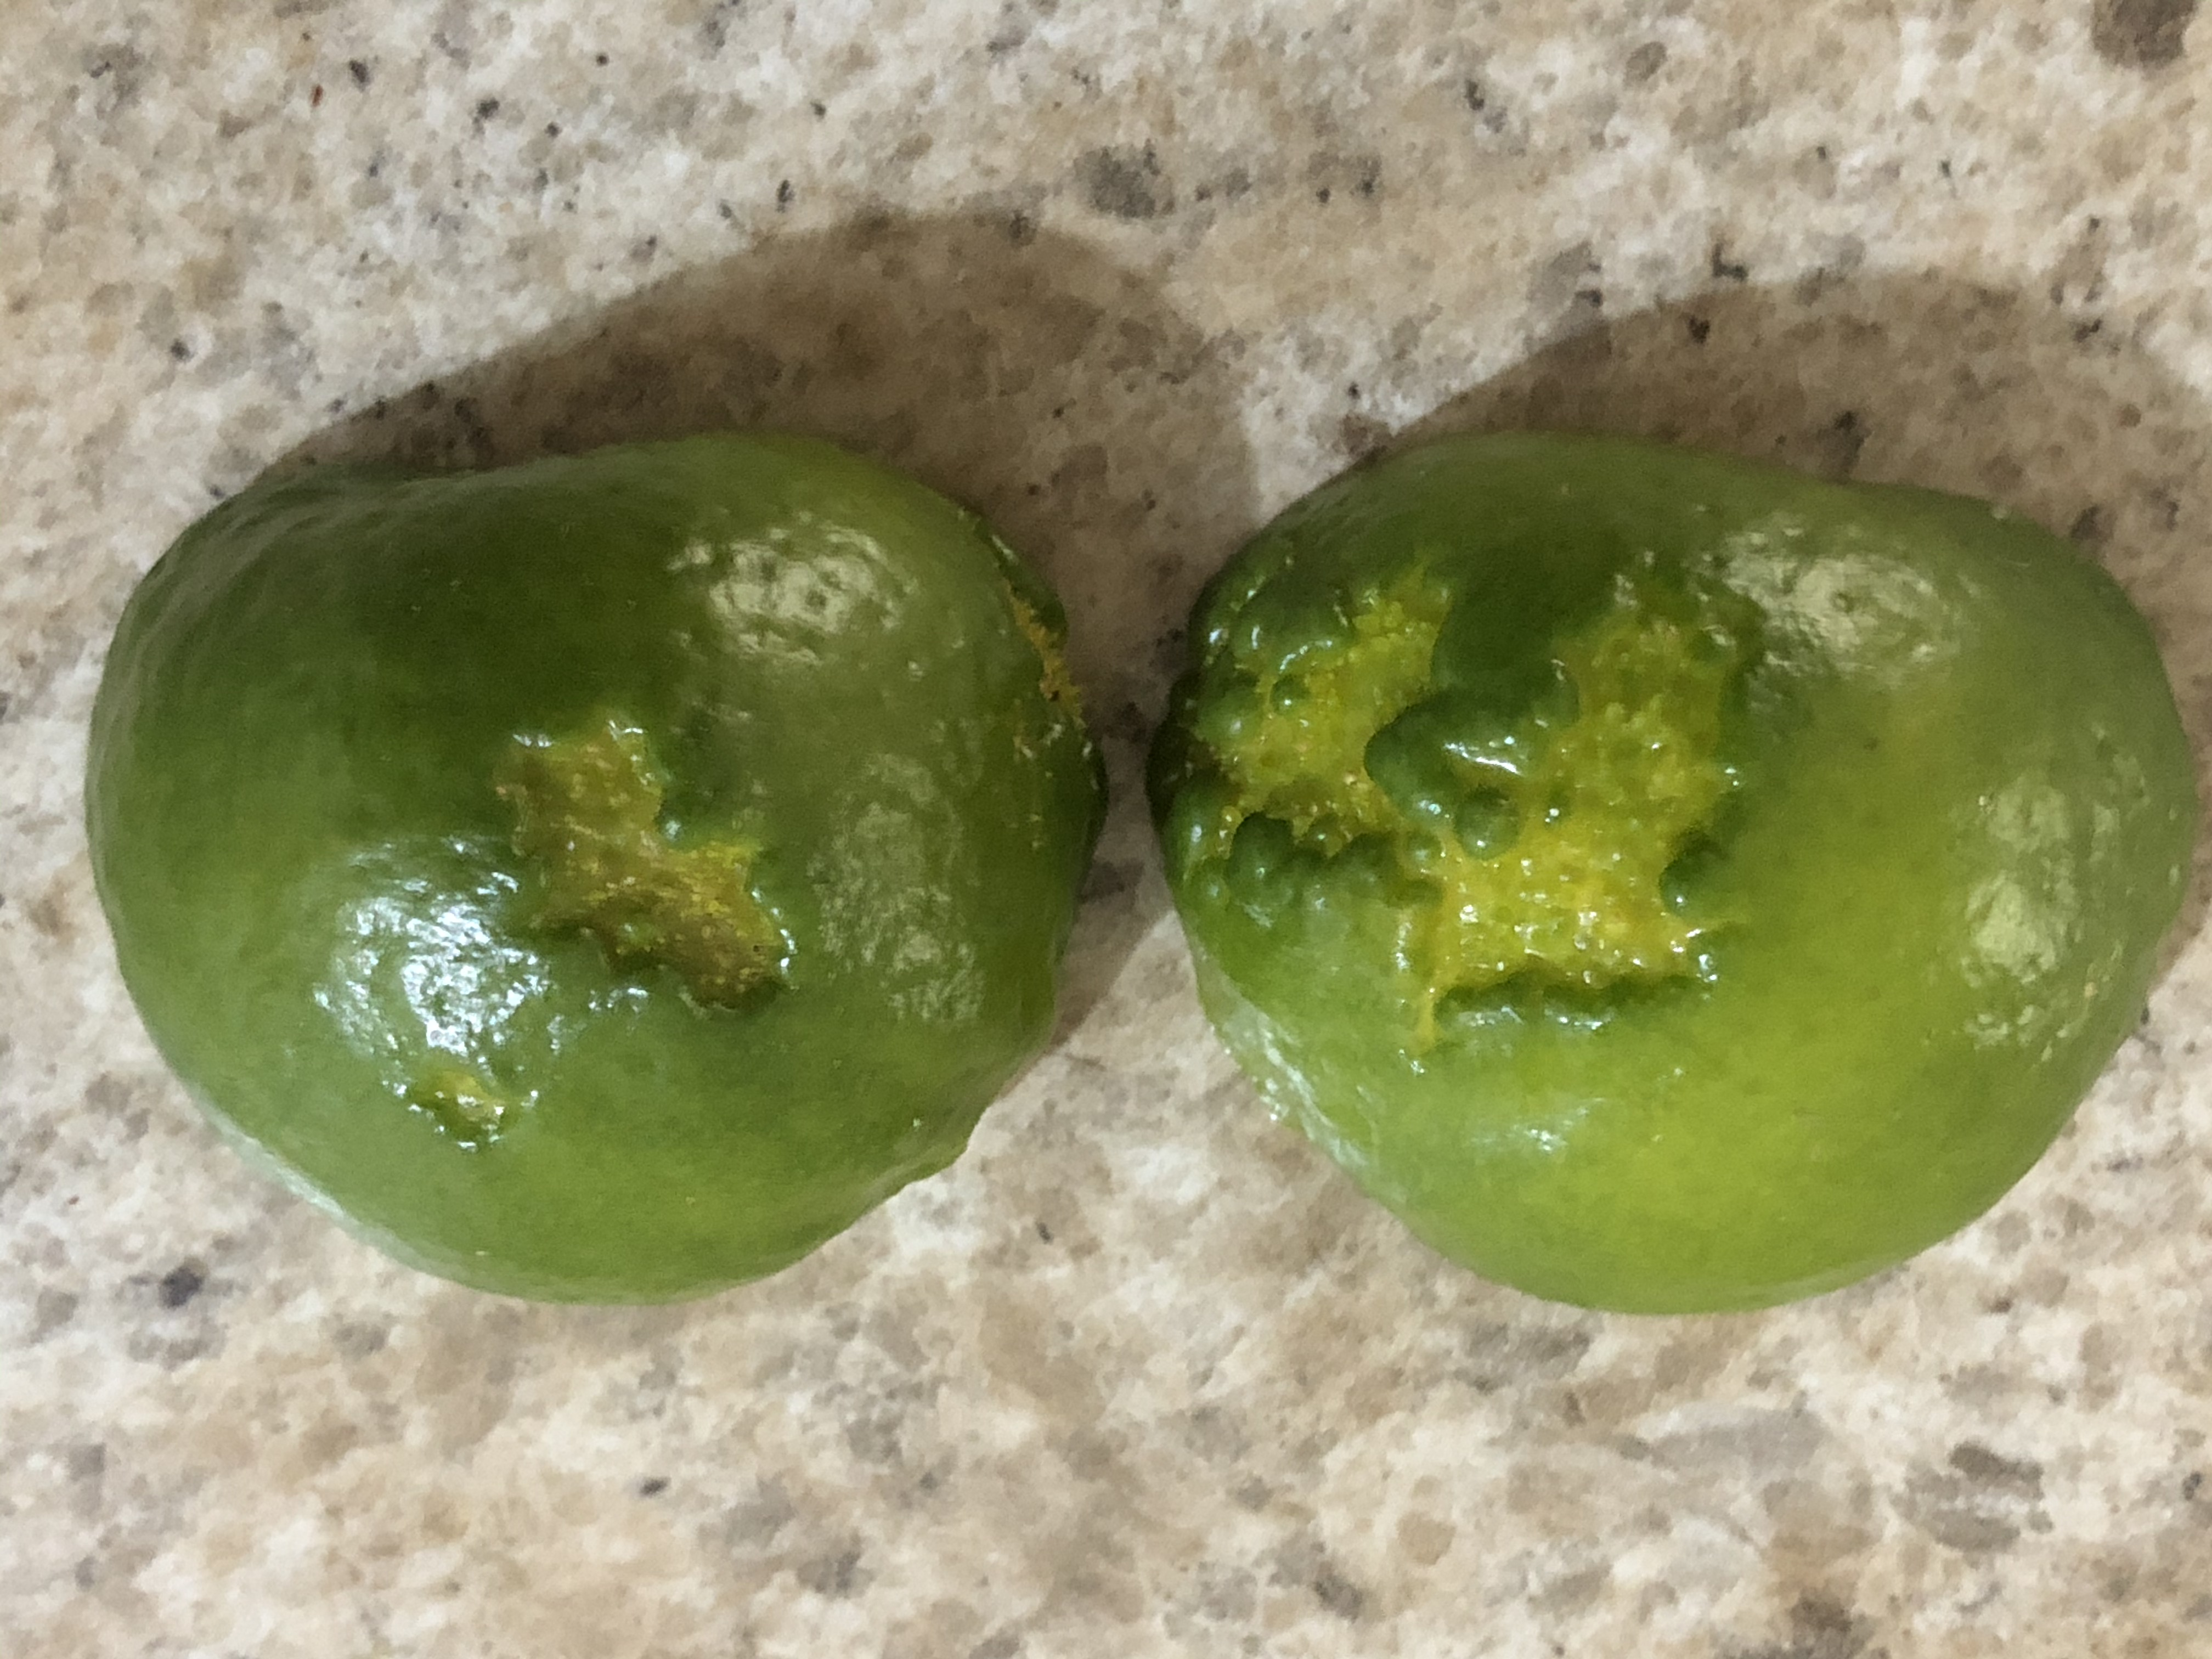
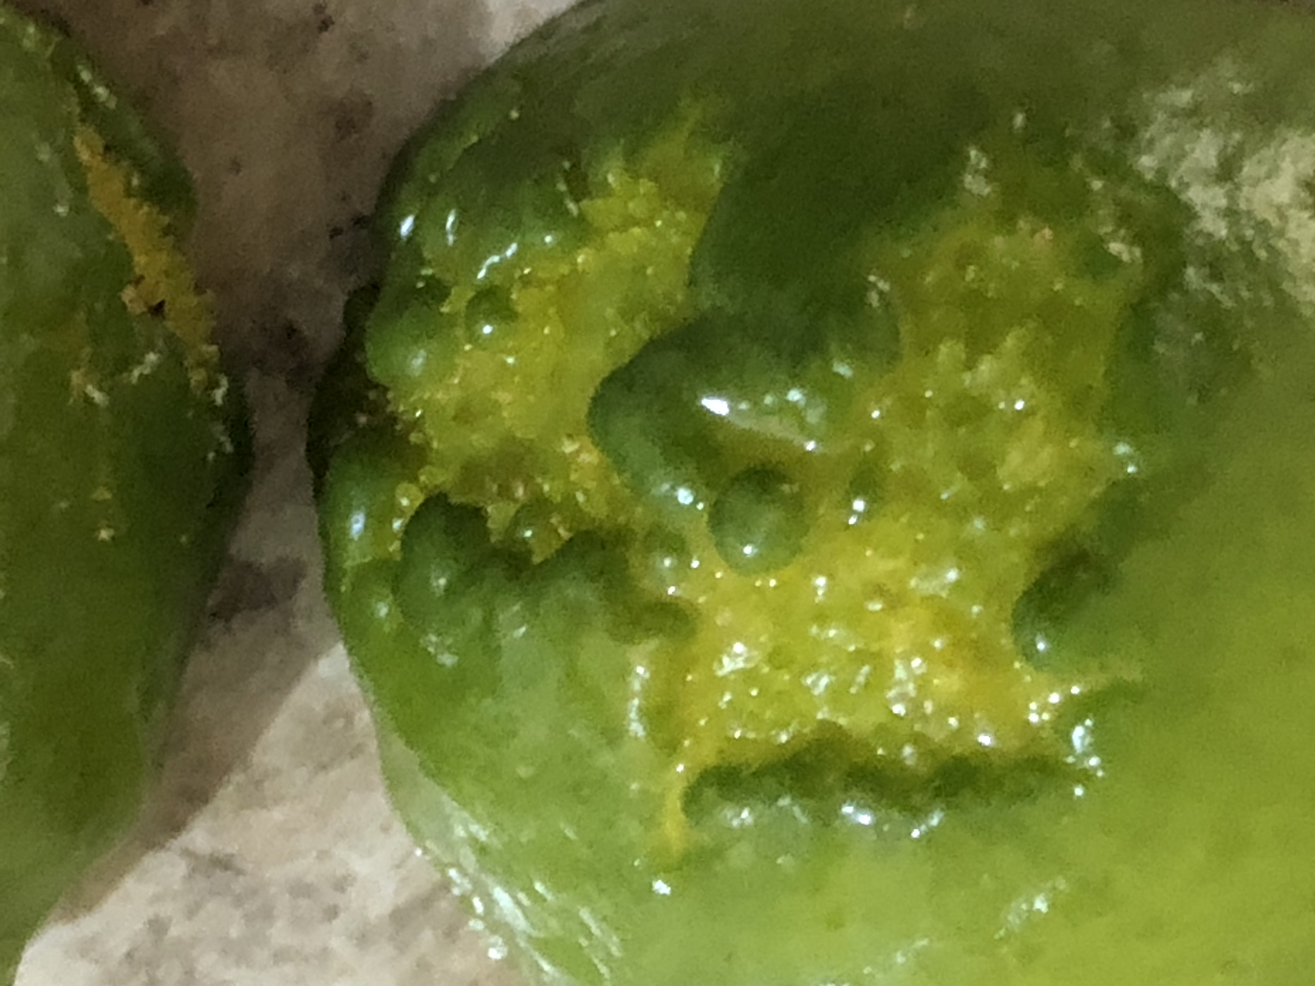
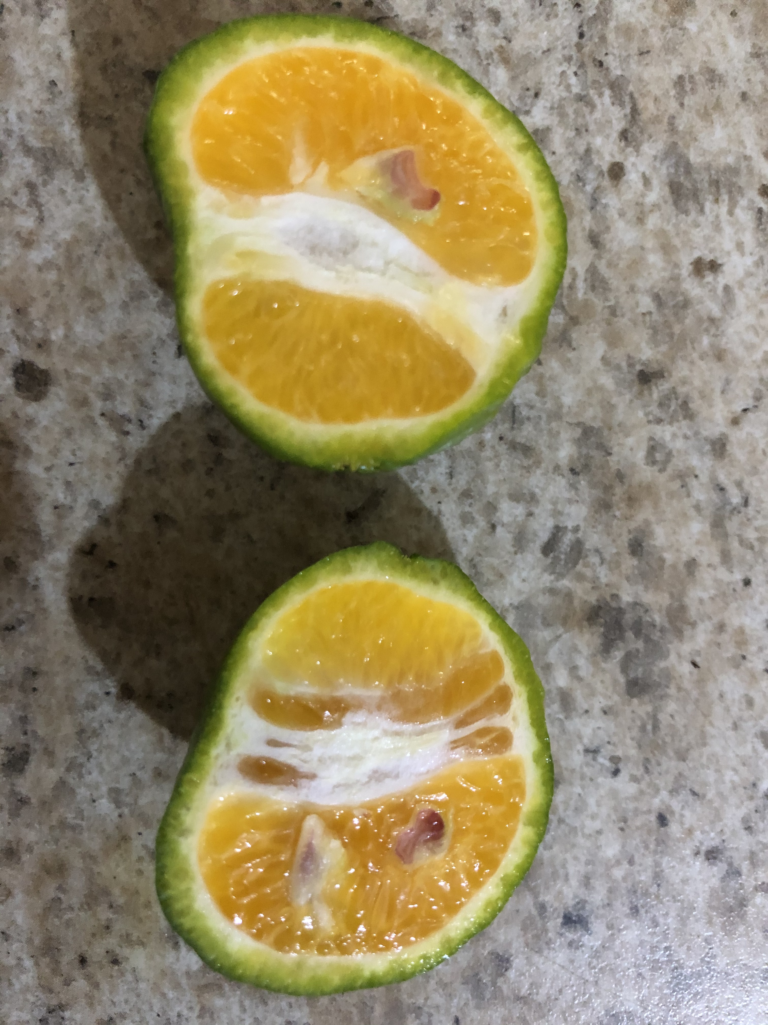
Fruit Fly or Not!

Slide 14
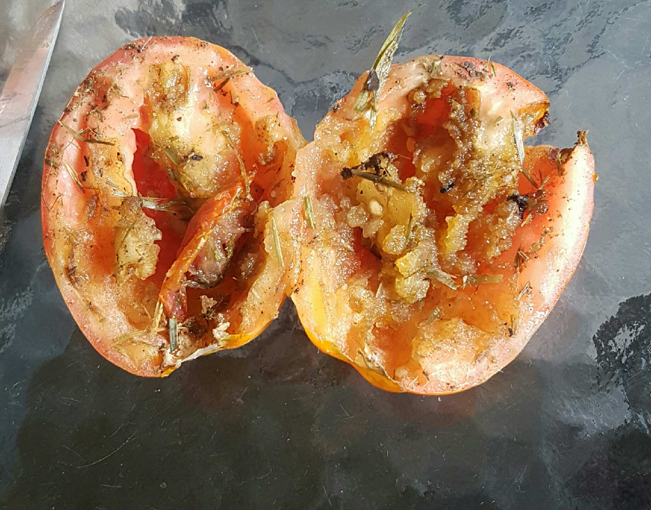
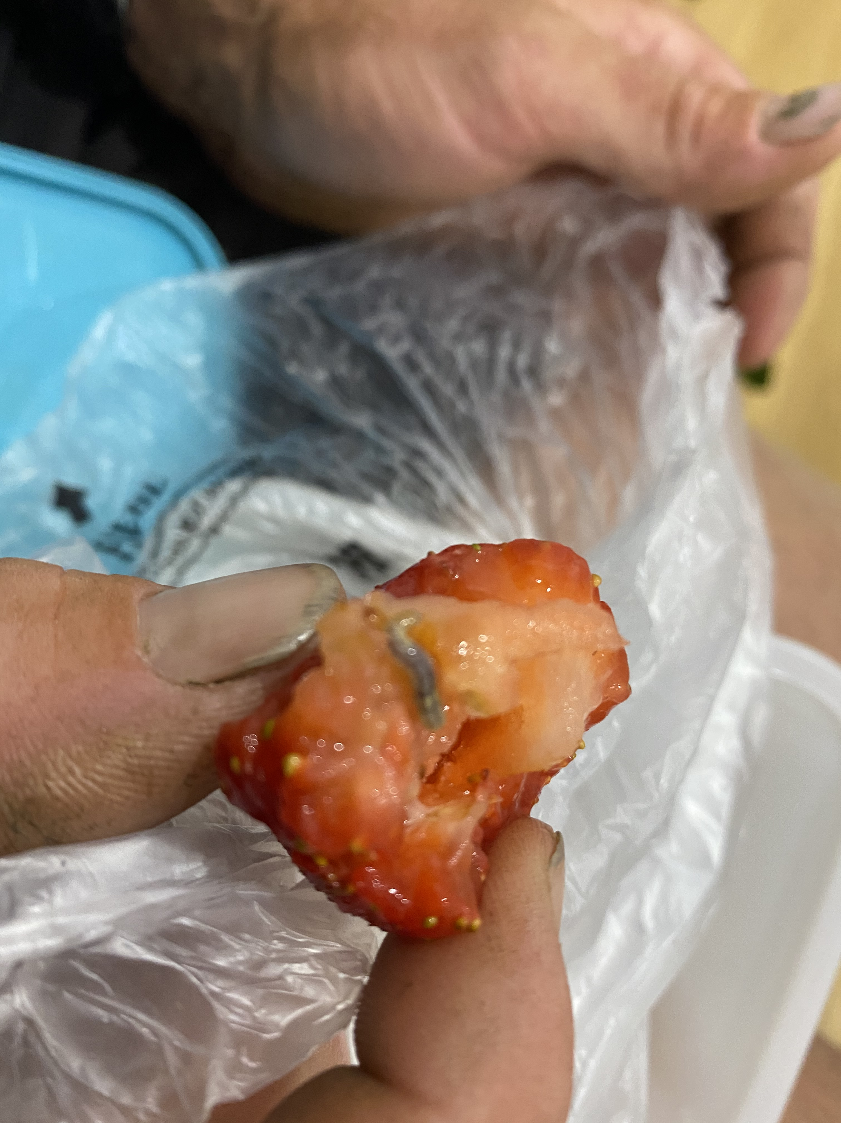
Fruit Fly or Not!

Slide 15
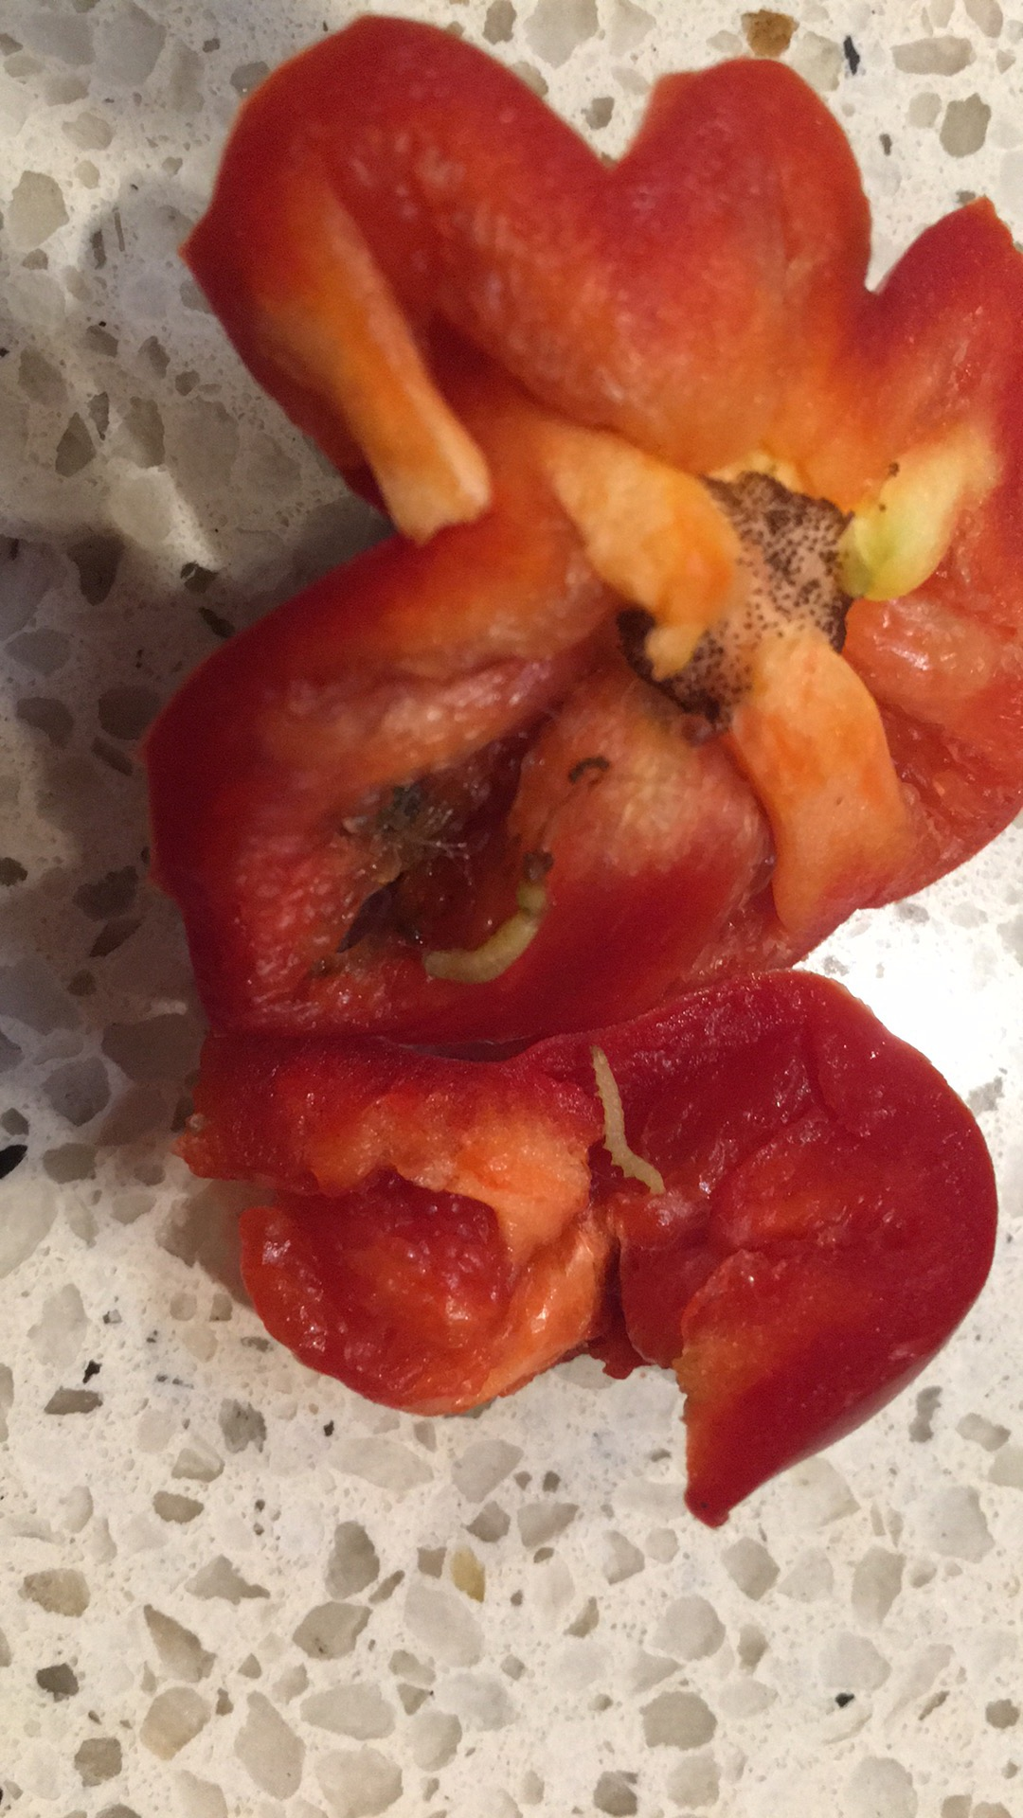
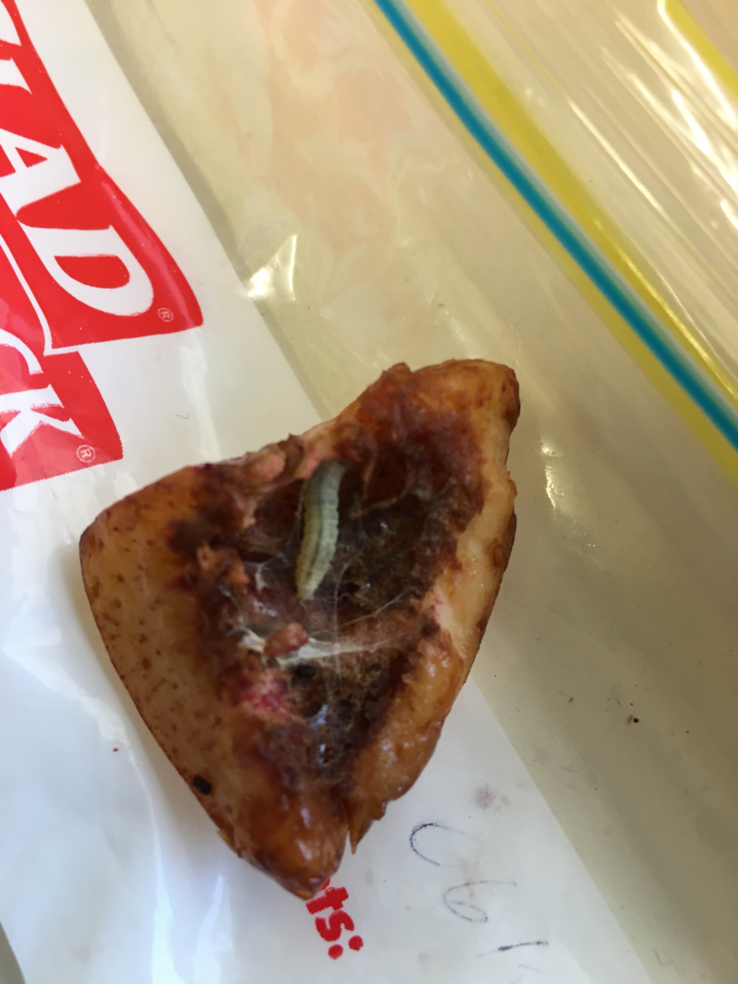
Fruit Fly or Not!

Slide 16
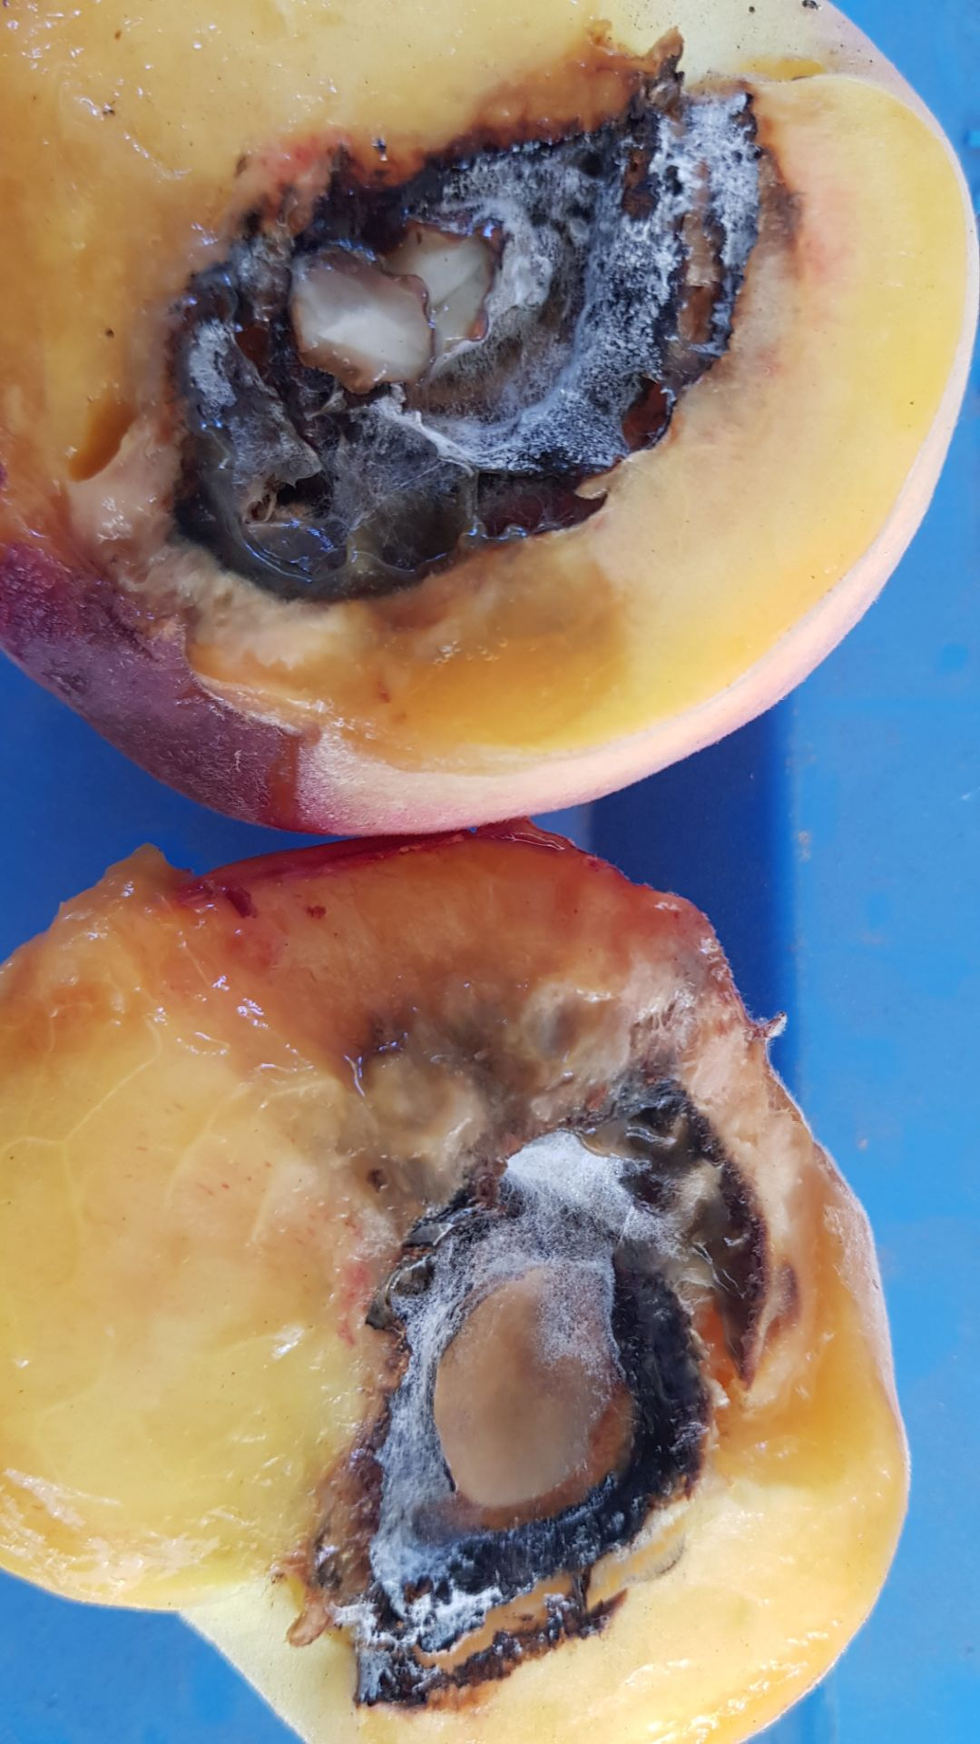
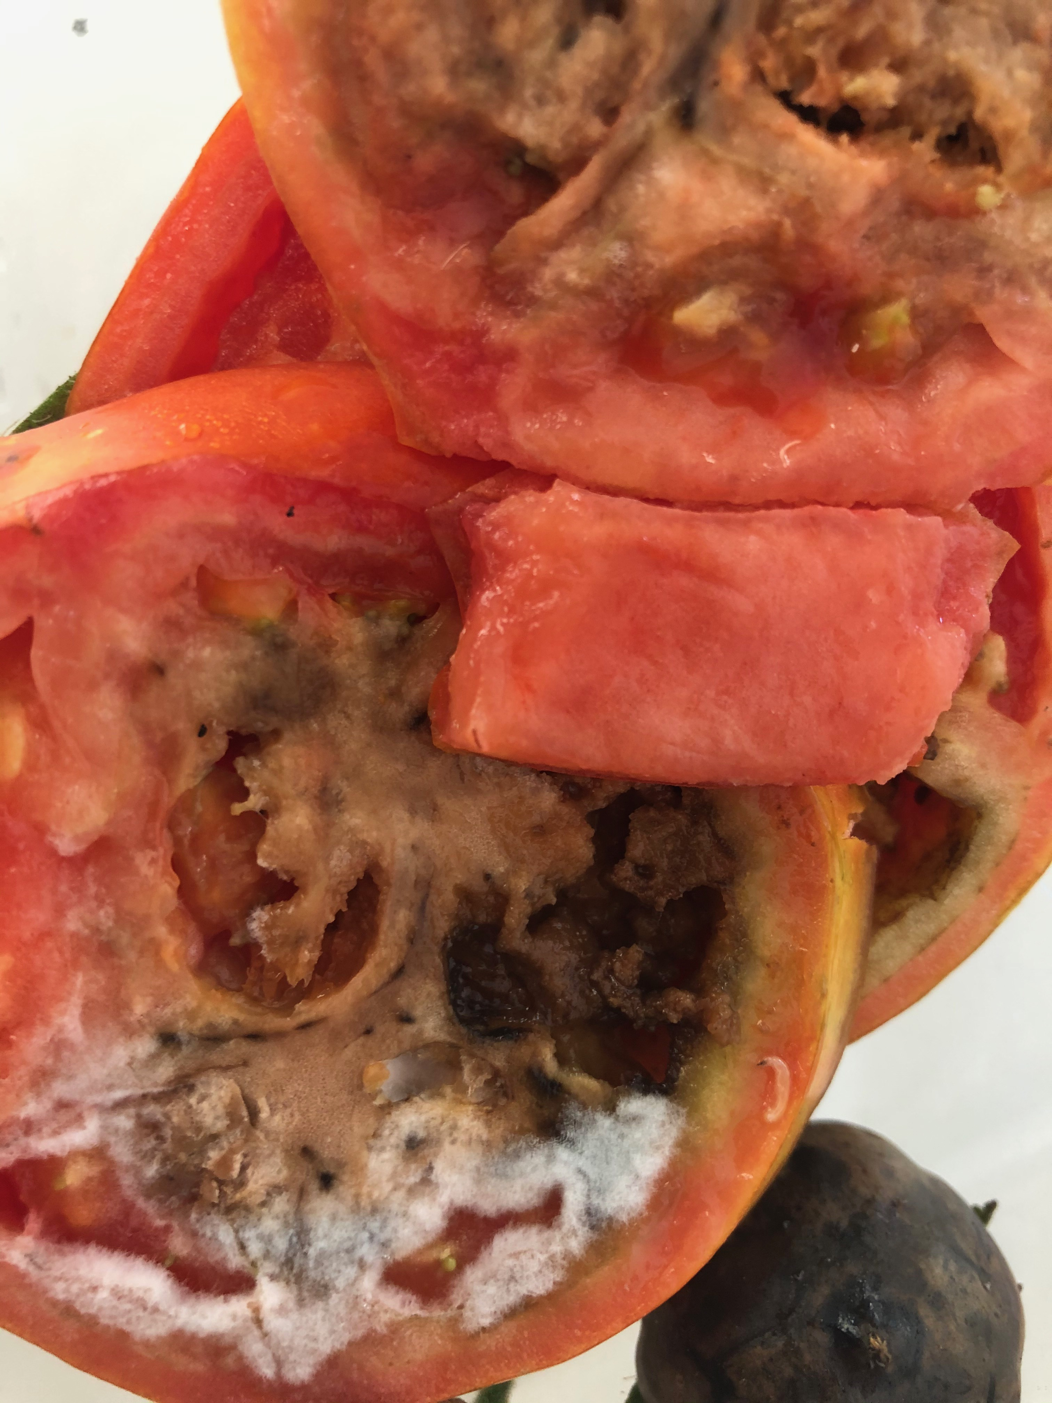
Fruit Fly or Not!

Slide 17
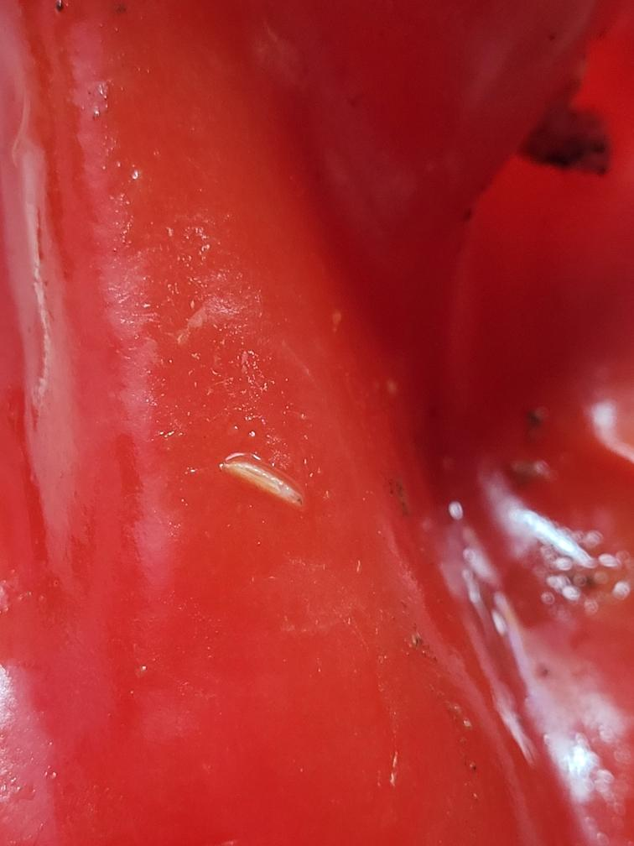
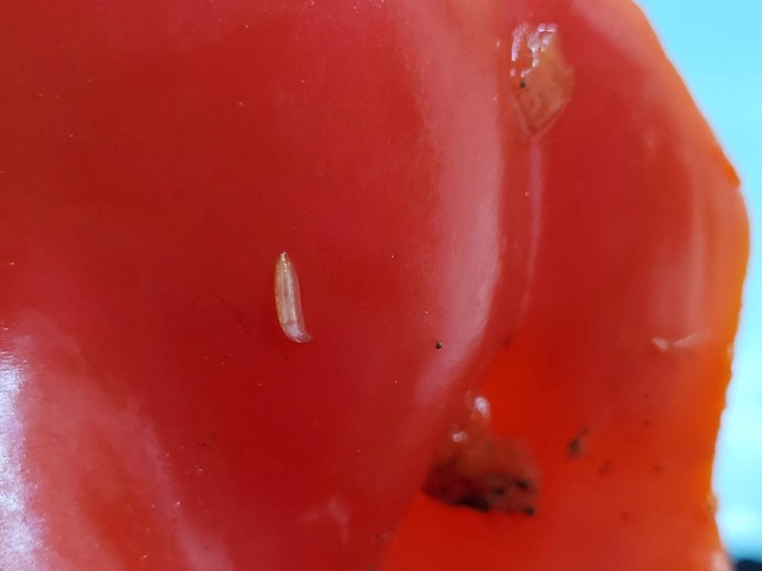
Fruit Fly or Not!

Slide 18
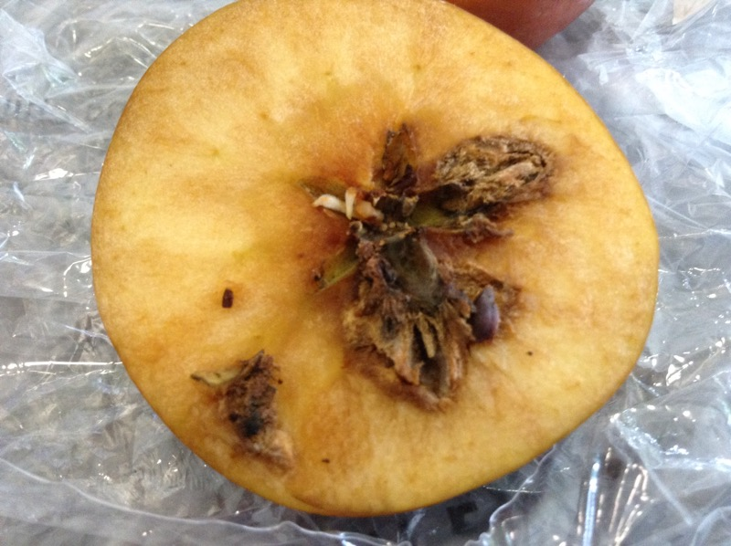
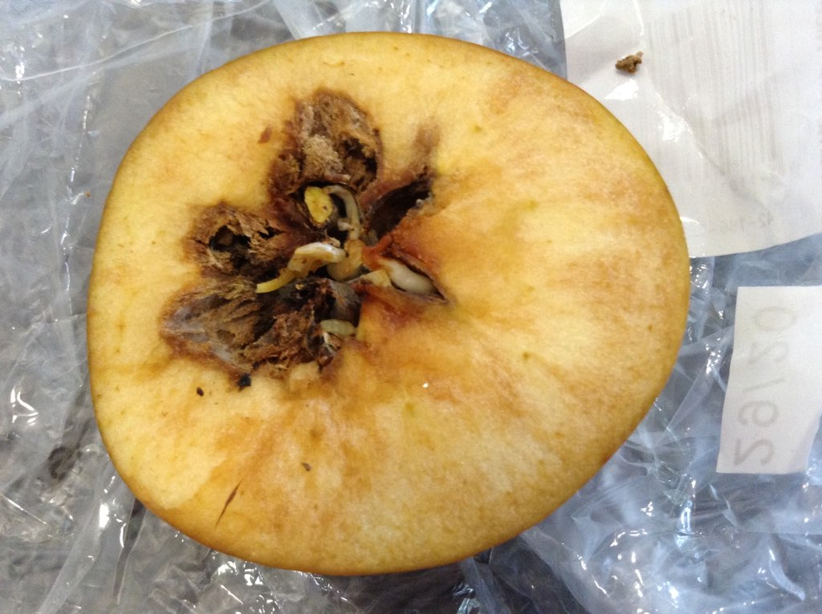
Fruit Fly or Not!

Slide 19
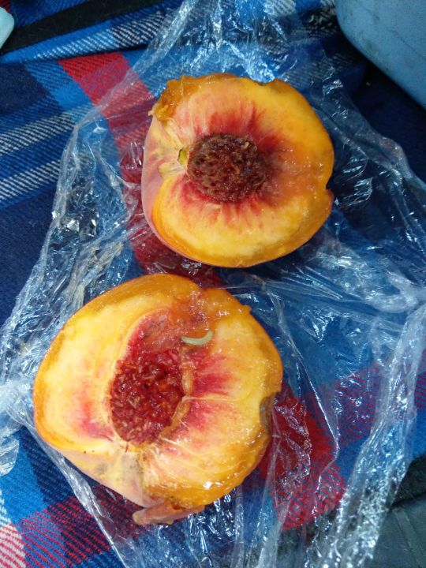
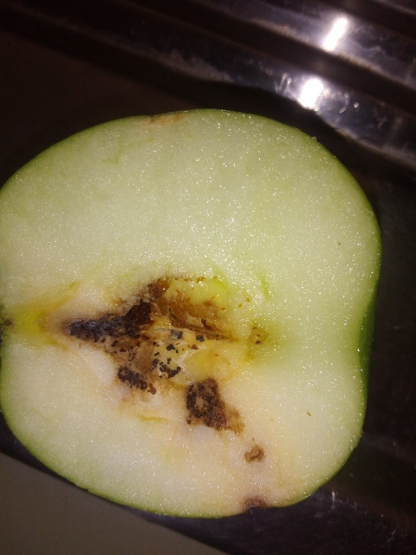
Fruit Fly or Not!

Slide 20
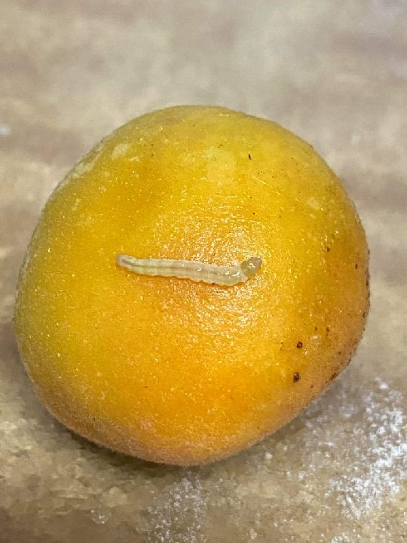
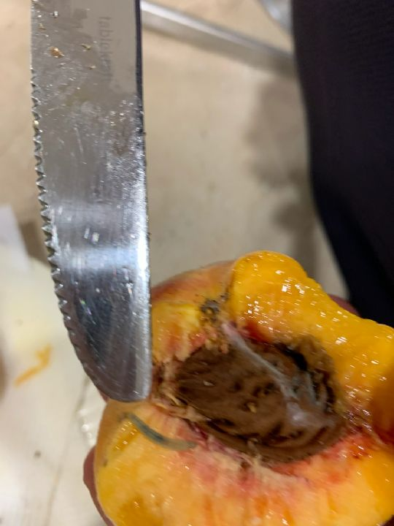
Fruit Fly or Not!

Slide 21
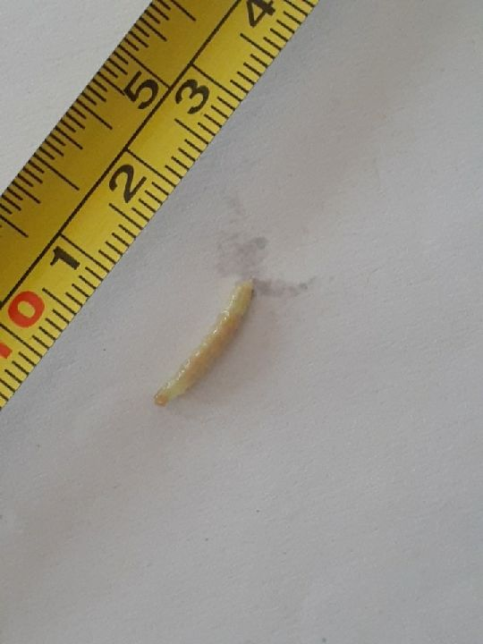
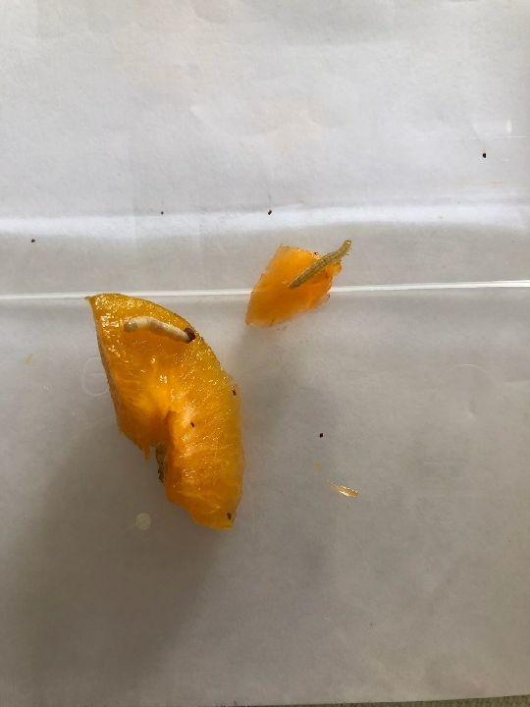
Fruit Fly or Not!

Slide 22
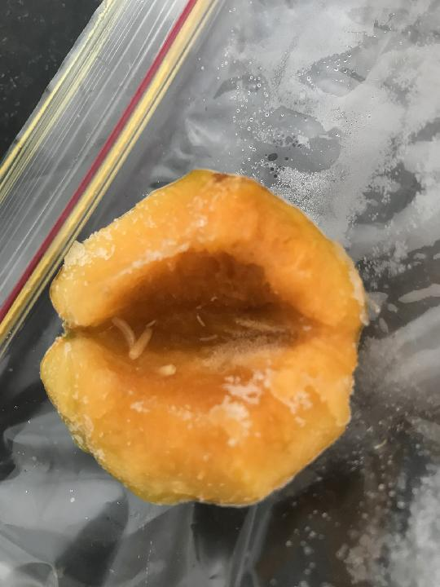
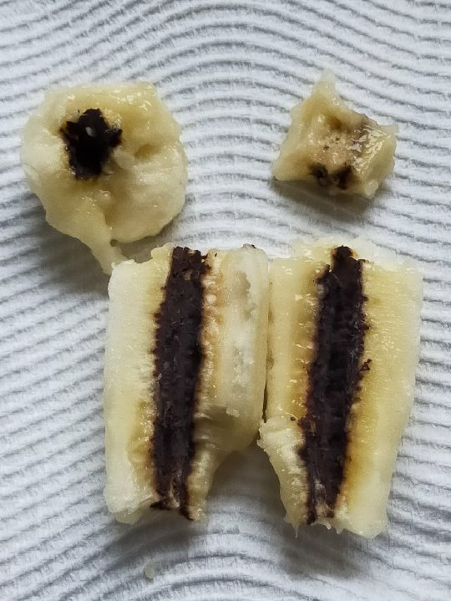
Fruit Fly or Not!

Slide 23
Fruit Fly or Not!

Slide 24
Any Questions?

