Slide 1

Managing Your Project – An Introduction to Project Management
Mark Priadko
July 2025

Slide 2

Welcome
We would like to acknowledge this land that we meet on today is the traditional land of the Kaurna people and that we respect their spiritual relationship with their country.
We also acknowledge the Kaurna people as the custodians of the Adelaide region and that their cultural and heritage beliefs are still as important to the living Kaurna people today.

Slide 3
Overview
The Context for Projects
Project Lifecycle
Project Initiation and Definition
Project Planning
Project Delivery
Project Completion and Articulation

Slide 4
Exercise – rank your work or project
Indicate your project or work in relation to it:
Familiarity – have you done this type of work before in this environment
The scale and risk – how high are the resource intensity, impacts and risk of my project/work

Slide 5
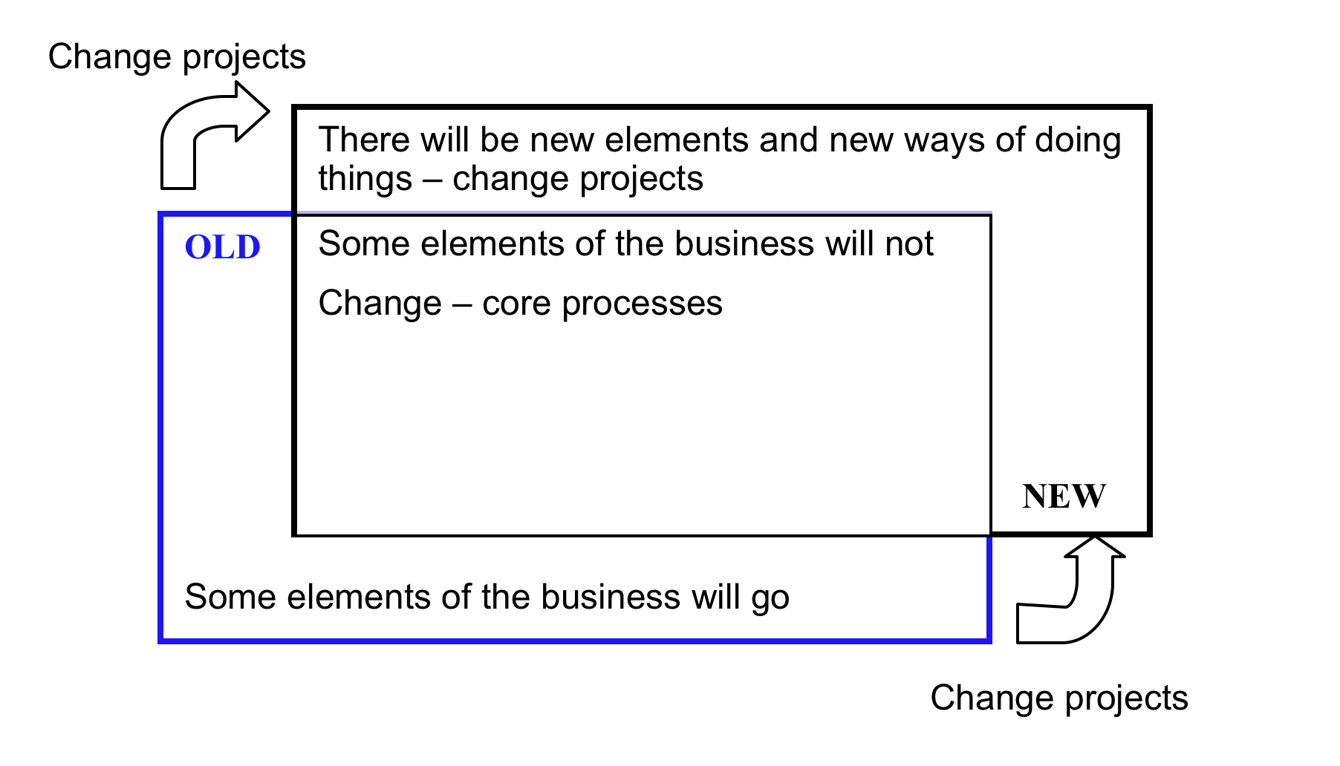
The Context for Projects

Slide 6
Discussion
How is project work different from operational (process) work?

Slide 7
Project vs Process
Project | Process
Unique - have not been done like this before | Do the same thing repeatedly
Are time limited with a start date & end date. Projects come and go. | They are ongoing and at the core of the business
Create something new or to implement a change | Create value or deliver outputs by repeatedly performing a task
Project objectives and plans can be changed by whoever gives the approval | Processes can only be changed with significant investment
Projects create change | Standardised processes are usually designed to resist change
Aim to amplify variation or change | Aim to reduce variation

Slide 8
Where projects fit
Demands or requirements | Unusual, unique, mysterious | Special request for a service or product, unique customer or idea from leadership Ideation, research and problem solving | Disruption from competition Adapting to changing demographics Exploring a new IT system Research projects and special projects | Large scale and complex projects (e.g. organisational restructuring, implementing a new IT system, major infrastructure Major Project
 | Familiar & regular | Serve customers, Produce monthly reports Specified Process | Regular high value transactions or events with a clear end-result (e.g. house-builder, produce annual report, conference/event management) Specified Project | Very high value projects or major events Major Project
 | Repeated and predictable | High volume of standard medium to low value transactions (e.g. retail store or library self-service, payroll processing) Automated Process
 |  | Smaller | Large | Very Large
 |  | Scale, level of disruption and risk to business

Slide 9
What is the story of your project
Use the project narrative template to document some details for your project

Slide 10
Overview
The Context for Projects
Project Lifecycle
Project Initiation and Definition
Project Planning
Project Tracking
Project Completion and Articulation

Slide 11
Project Lifecycle
Follow up project
Life cycle stage
Idea, opportunity, issue
Project initiation
Project planning
Project delivery
Project completion (or termination)
Transition into
Ongoing operations
Gateway & approval
Approve concept and proceed to initiation
Approve design and proceed to planning
Approve and fund the plan and proceed to delivery
Review against the plan to approve completion
Handover to operations with ongoing budget
Exhibits
Business case
Project Brief
Logic
Structure
Calendar
Budget
Risk register
Status reports
Updated calendar
Finance variances
Change requests
PIR
Updated operating procedures
Closure report
SOP and operating budget
Budget method
Business sets funds aside
Initial Whole of life costs
Detailed budget
Monitor finances and update detailed operational budgets
Acquit project funds against budget
Proceed with operating budget

Slide 12
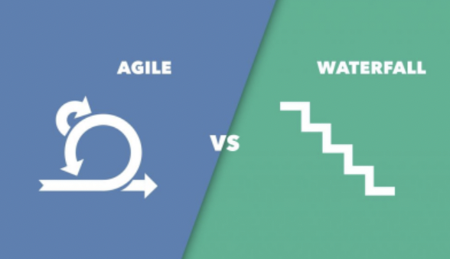
Waterfall and Agile
Agile
Project evolves with delivery occurring over a number of short iterations
Planning occurs with each iteration
Essentially an Agile project consists of a series of smaller
Waterfall
Project places greater emphasis on upfront planning
Aim to follow the lifecycle once
Heavy emphasis on upfront planning

Slide 13
Beware the project over the hill
When the end result is not known at the beginning and only becomes clearer after milestones have been reached. Example, time and cost to implement a new system are not known until the system has been procured.
Think of this as two overlapping projects
Identify and select the system – now the other side of the hill can be seen and understood
We start here
New system is implemented
Select and procure the finance system
Implement the finance system

Slide 14
Project Lifecycle
Idea, problem or opportunity
Initiation and Definition
Planning & Specification
Delivery
Completion
Project concept requires approval for move to detailed planning
Project Plan requires approval to proceed to deliver
Approvals required to continue or change
Sign off or acceptance to complete
Approvals required
Brief
Logic
Business Case
Structure
Calendar
Budget
Risk Schedule
Status reports
Updated calendar
Change request
Financial reports
Sign off letter or acceptance document
Project Exhibits

Slide 15
Overview
The Context for Projects
Project Lifecycle
Project Initiation and Definition
Project Planning
Project Delivery
Project Completion and Articulation

Slide 16
Project Initiation and Definition
Logic – deliverables, achievements and outcomes
Scope – boundaries, inclusions and exclusions
Who – Governance, stakeholder and decision making

Slide 17
Definition & Design – the Logic of our project
What should we do?
What will we deliver?
What do we want to achieve?
In Design – start to build the logic from right to left & iterate
Project design focus
Project planning focus
Inputs
Activities
Outputs
Objectives
Outcomes
Resources or materials used by the program to provide its activities (e.g., staff, supplies, equipment)
The task, methods and approaches we want to employ to undertake our work
The goods or services provided by the program or project described in quantifiable terms
What the outputs are designed to achieve in the short term
What is expected to change or improve in the longer run as a result what we deliver
In delivery – work from left to right
Our planned work and activity
Our intended results

Slide 18
Program Logic: Approach
Program Logic – your approach to conducting a project that represents the choices made about - why, what, how and who.
Why – why does your project exist – this is ultimately a question of value
What do you deliver that is of value
How – how do you produce and deliver
Who – who is the beneficiary of what you deliver and who else is necessary to make the business work.

Slide 19
How we think about our project
What is your program logic?

Slide 20
For your project
How will you know if your project has been successful?
  What outputs will have been delivered?
  What objectives achieved?
  What outcomes occurred or made possible?

Slide 21
Clarify Scope
IN-SCOPE | OUT-OF-SCOPE
Size or scale Timing and duration Limited to locations, teams or regions Beneficiaries and people impacted | What the project won’t do or deliver
Unresolved matters of scope:
Via Negativa – what won’t the project do
Via Positiva – what assumptions are we making

Slide 22
In project initiation and design - Lets talk about scope
Life cycle stage
Idea, opportunity, issue
Project initiation
Project planning
Project delivery
Project completion (or termination)
Follow up project
Transition into
Ongoing operations
Good scope
Specified requirements using concrete nouns
Parametric limits (e.g. locations, number of users, number of rooms)
Defined completion – the project will be completed when….
Authority is defined
Scope is documented
We define what is out of scope – capture what the project will not do
Bad Scope
Vague requirements overusing abstract nouns
No documented limits or scale restrictions
Not sure when we will be finished
Not sure who is actually in charge - anyone can add in requirements
Word of mouth and oral instructions

Slide 23
Clarify Scope
Project Scope
IS (in scope) | IS NOT (out of scope) | Stakeholder
What the project will do and will achieve | What the project will not do and will not achieve
Not Resolved
Objectives
Via Negativa – what won’t the project do
Via Positiva – what assumptions are we making

Slide 24
Who decides what?
Project Managers negotiate with sponsors to ensure their outputs are aligned with objectives and outcomes
Sponsors negotiate with Executive or with Boards to ensure their outputs and objectives are aligned with outcomes
Inputs
Activities
Outputs
Objectives
Outcomes
Scope of Workers
Scope of Project Managers
Scope of Sponsors

Slide 25
Stakeholders
Critical – have authority to stop and start the project
Essential – you need their cooperation
Interested – they may be impacted and we want to keep them informed
Also consider stakeholders you need at each phase in the lifecycle

Slide 27
Justification
Does your project need to be justified?
The PRAISE logic can help us outline aspects of justification.
More detail is provided in the Appendices

Slide 28
Overview
The Context for Projects
Project Lifecycle
Project Initiation and Definition
Project Planning
Project Delivery
Project Completion and Articulation

Slide 29
Project Planning
What are the major elements (stage or phases) of your project?
How will you know when each one is finished?
Project Planning
Project Development Strategy & WBS
Project Calendar
Project Budget
Project Risk

Slide 30
Project Development Strategy
Linear Sequence Strategy
Concurrent Stage Strategy
Concurrent Sub Stage Strategy
Fast Track Strategy

Slide 31
Strategy – how we’ll go about change

Slide 32
Work Breakdown Structure

Slide 33
What does the Calendar look like?

Slide 34
Dependencies & the critical path
Finish to start – a Predecessor must finish before a Successor can start. Example: Slab must be laid before frame can be built.
Start to start – a Predecessor must start before a Successor can start. Example: Writing of a document has to have started for editing to have started.
Finish to finish – a Predecessor must finish before a Successor can finish. (i.e. tasks could be being performed in conjunction, but they must finish in a particular order.) Example: Cannot complete application until exam results are finalised.
Predecessor
Successor
Predecessor
Successor
Predecessor
Successor

Slide 35
Project Budget
How would we go about estimating the cost of a conference?

Slide 36
Developing a zero based budget
What are the transactions and activities?
Make assumptions for key transactions and activities
Convert into $

Slide 37
BUDGETING
Transactions and activities | Assumptions | $

Slide 38
Risk – what could possibly go wrong?
List what could go wrong within the design and plan you have prepared
Ask yourself – am I being optimistic about this project?
Initial thoughts – how do I address these uncertainties or my biases?

Slide 39
Risk biases and effects
Optimism bias
Confirmation bias
Affect bias
Availability bias
Anchor effect
Naivete

Slide 40
Overview
The Context for Projects
Project Lifecycle
Project Initiation and Definition
Project Planning
Project Delivery
Project Completion and Articulation

Slide 41
Project Delivery
Tracking & monitoring
Idea, problem or opportunity
Initiation & definition
Planning & specification
On track – keep going
Completion
Off track – adapt
Off track – redesign & or re-plan
Project Delivery requires:
Tracking and reporting
Adapting our project to variations and surprises
Seeking approval to change our project
Getting to completion

Slide 42
Activity
What do we observe for our conference from the handouts provided?
See the example of project status report
If our project is not on track, what options do we have for getting it back on track

Slide 43
My Day in ‘Deni'

Slide 44
My Day in ‘Deni'

Slide 45
Adapting
Adapting within our design and plan by using time or money saved to date or by bringing forward work
Adapting by changing our our design and plan – this requires renegotiation of key design parameters:
  Time
  Money
  Deliverable requirements or cost
Deliver the project on time
OFF
ON
Meet an agreed budget
OFF
ON
Meet output/deliverable requirements
OFF
ON

Slide 46
Trade offs
Time
Quality
Cost
Cost
Time
Risk
Time
Cost
Quality
Scope
Quality
Scope
Stakeholder satisfaction

Slide 47
What else could be renegotiated
Have a satisfied client group
OFF
ON
Deliver the full scope of outputs
OFF
ON
Deliverable quality requirements are met
OFF
ON
Quality indicator 1
OFF
ON
Quality indicator 2
OFF
ON
Quality indicator 3
OFF
ON
Have a sense of professional satisfaction for the team
OFF
ON
Source: Adapted from Thomsett Project Management
Renegotiation of key design parameters should be documented with a project change request

Slide 48
Project Completion
What does project completion look like for your project?

Slide 49
Post Implementation Review
Enables us to measure and celebrate success
Helps us learn to improve the next project
Marks the end – psychological milestone.
Basic PIR Survey Questions
Did the project deliver what it said it would?
Was the quality of deliverables up to expectations?
Was the project on schedule?
Did the project meet its objectives?
Will the outcomes sought from the project occur or have they occurred?
Did the project come in on budget?
What were the causes of variance to budget?
What uncertainties arose that we did plan for?
What uncertainties arose that we did not expect?
What were the most important lessons learned from this project?

Slide 50
Overview
The Context for Projects
Project Lifecycle
Project Initiation and Definition
Project Planning
Project Delivery
Project Completion & Articulation

Slide 51
Project Exhibits
We have already worked with a number of project exhibits:
Program Logic
Work Breakdown Structure
Calendar (planning & update)
Finances (budget & reporting)
Risk assessment and Register
Status reports
Activity – for our conference, what might need to be included in a communication plan

Slide 52
Communication Plan
Refer back to our stakeholders:
Critical
Essential
Interested
Communicate change clearly
What will continue ‘as is’
What will go
What will be new

Slide 53
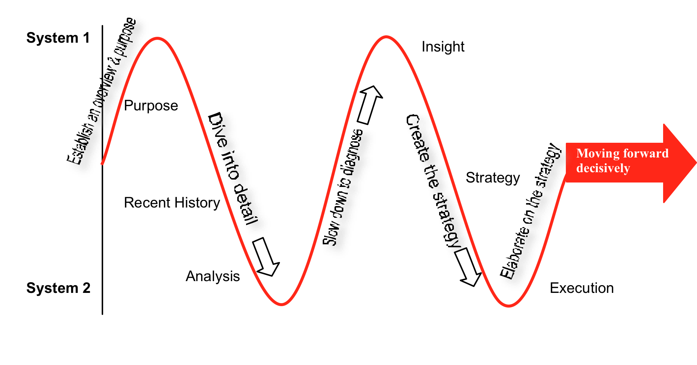
Project Articulation - PRAISE

Slide 54
Insight is at the heart
Research and analysis into the context, history and nature of the issues or problems
Strategies, solutions and action plans that will deliver the changes required
Insight – understanding causes and the need for change

Slide 55
Purpose – what could be included
Name and description
Strategic Context
  Links to strategic plans
  Benefits to the council, to business, to residents
  Legislation & compliance
Define success and excellence
Outcomes and Objectives sought

Slide 56
Recent history – what could be included
Historical context behind the initiative – where has the need emerged from
Trends that have led to the need for this project being contemplated (trends in activity and workload, trends in technology, social and demographic trends)
Recent events that highlight an issue or opportunity
The age of existing assets, technology or outdated approaches may be relevant.

Slide 57
Analysis – what could be included
Analysis of the current or default state – what will happen without change
Analysis of opportunities that have arisen that warrant change
Evidence of activity, utilisation, workloads that highlight the need for change

Slide 58
Insight – what could be included
A truth confirmed and restated – old information confirmed, truism
Revelation – A discovery of why things are like they are - acceptance
A realisation of the need to change
Realisation of an opportunity
A diagnosis
The end-result of the evaluation of options or of evidence - judgement
An ‘Ah ha’ moment – When several thoughts thread together and make sense.

Slide 59
Strategy – what could be included
Project Development Strategy
Stakeholder lists and the Quality expectations of stakeholders
Resource requirements – Budget and skill requirements
Assumptions and constraints being made
Risk assessment

Slide 60
Execution – what could be included
Project execution plan
Calendar of events and stages
Work Breakdown structure
Change management plan

