Slide 1

Preparing documents
MARK PRIADK0
August 2025

Slide 2
We would like to acknowledge this land that we meet on today is the traditional land of the Kaurna people and that we respect their spiritual relationship with their country.
We also acknowledge the Kaurna people as the custodians of the Adelaide region and that their cultural and heritage beliefs are still as important to the living Kaurna people today.

Slide 3
Overview
The purpose of our documents
Our audience and the curse of knowledge
Distinguishing content and method
How we arrange content
Method – how we go about writing

Slide 4
Activity
Please put yourself in the position of an Executive with the authority to make decisions about funding and recruitment.
I have prepared a briefing for you to consider called ‘Assessment of a review to appeal’.
Please read the briefing.
In groups discuss your observations, critiques and questions.

Slide 5
Ways to improve the assessment document
Clearer intent
Change the structure and length of the document
Increase the use of plain language
Use of passive voice that could be converted to active voice
Use of constructions based on nouns that could be converted to verbs.
Preferring short sentences over long
Less ambiguity about the subject or object.

Slide 6
Types of documents
No change required | Change required but how is not yet clear | Change required and understood
Inform, assure | Discussion | Decision making
Recommends - Noting | Recommends – direction for further work | Recommends – action to implement change
INFORM
DISCERN
DECIDE
ACT

Slide 7
Overview
The purpose of our documents
Our audience and the curse of knowledge
Distinguishing content and method
How we arrange content
Method – how we go about writing

Slide 8
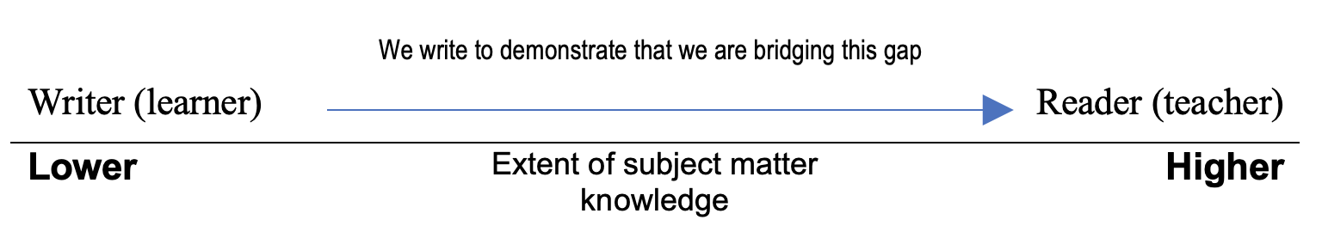
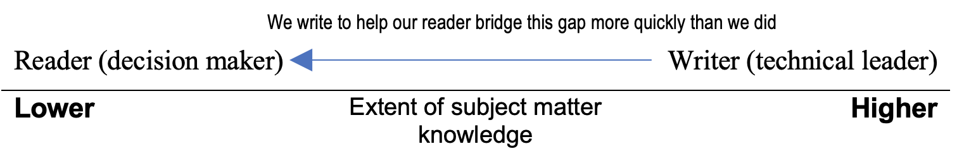
Beware the curse of knowledge

Slide 9
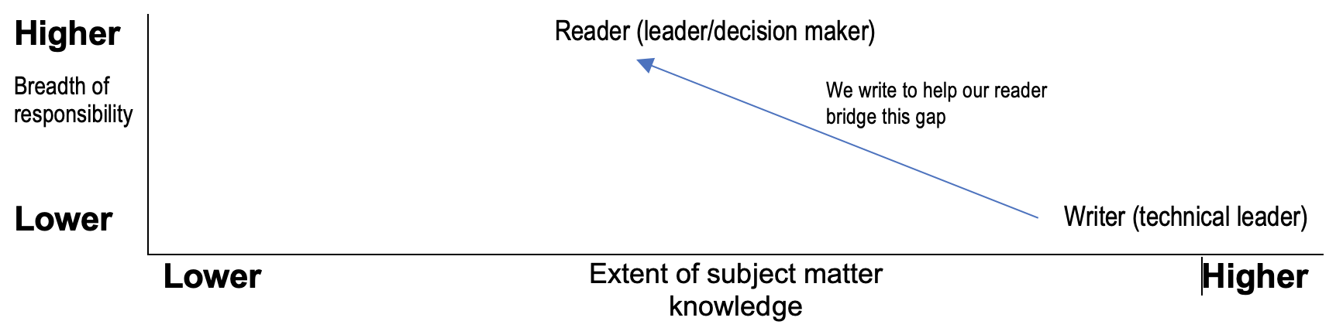
Beware the curse of knowledge

Slide 10
Make a commitment to the concrete
“When we know something well, we don’t realise how abstractly we think about it… We need to slice away abstraction and show the reader who did what to whom.” Stephen Pinker.
Concrete nouns name things you can identify through one or more of the 5 senses.
Abstract nouns name intangible things, things that cannot be seen. These include ideas, emotions and physical feelings.
A security firm might say – We believe our approach to delivering integrated solutions, combining effective manpower, canine services and cutting-edge technology is a key differentiator in the selection process
We might prefer – They chose our company because we protect buildings with a combination of guards, dogs and sensors.

Slide 11
Converting our language
Use more familiar and everyday words
Be precise by removing unnecessary words
Vary sentence lengths
Prefer active voice to passive voice
Use verbs in preference to constructions based on nouns derived from verbs
Break up dense strings of nouns
Avoid cliché’s
Clarify jargon, acronyms and initialisms
Answer rather than respond
Ambiguity of subject

Slide 12
Thoughts from writers who write about writing
Use active verbs more than passive verbs
Overuse of adverbs and adjectives
Qualifiers erode authority
Overstatement can erode credibility
Prefer short sentences and paragraphs to long
Be aware of how we were taught to write

Slide 13
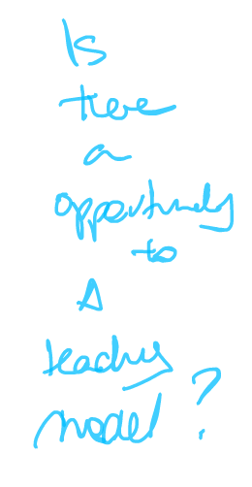
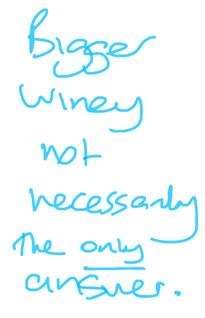
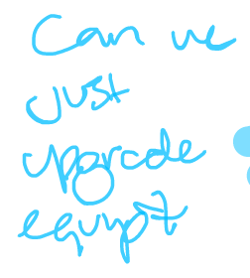
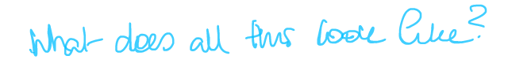
What decision makers want
Feedback from a recent business case (education sector)
Decision makers want:
Context
Evidence
Different perspectives
Root Causes
Options
Solution details
facility

Slide 14
Overview
The purpose of our documents
Our audience and the curse of knowledge
Distinguishing content and method
How we arrange content
Method – how we go about writing

Slide 15
Activity
Group 1 – Doing the review
What information would we expect to be included in the report
How would you go about conducting the review and preparing the report
Group 2 – Updating the CE on the review
We are asked to prepare a briefing for the CE on the status of the review of an Office attached to the department.
What information could be included in the briefing?
How should we go about preparing the briefing?

Slide 16
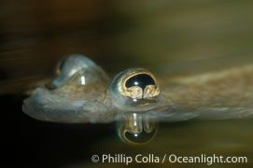
Content vs Method
‘Above the surface’
Content
What the document contains
How you go
about producing it
‘Below the surface’
Method
Anablep =- “four-eyed fish” – Actually two eyes each with two retinal regions.
Both eyes are divided into aerial and aquatic parts. The two retinal regions of each eye, working in concert with two different curvatures of the eyeball above and below water to account for the difference in light refractivity for air and water, allow this amazing fish to see clearly above and below the water surface simultaneously.

Slide 17
Overview
The purpose of our documents
Our audience and the curse of knowledge
Distinguishing content and method
How we arrange content
Method – how we go about writing

Slide 18
Narrative Structure
“Narrative is the choice of which events to relate and in what order to relate them – so it is a representation or specific manifestation of the story, rather than the story itself.”
Write to tell or write to discover – this is our choice about sequence.
When we tell we will present findings first and support them with facts and data second.
We tell to inform
When we reveal for the reader to discover we present facts and data first and findings second
We use revealing and discovery to engage our reader and persuade

Slide 19
Write to tell or to discover
When we tell we will present findings first and support them with facts and data second.
We tell to inform
When we reveal for the reader to discover we present facts and data first and findings second
We use discovery to persuade

Slide 20
Narrative Structures
Some examples of basic non-fiction narrative structures:
Past – Present – Future
Beginning – Middle - End
Why, What, How and What’s next
Context – Discussion – Findings - Recommendation

Slide 21
Templates
Briefing templates
Business case templates

Slide 22
Pyramid for information papers
Example for a finance report
Overview and headlines
Results by team or line
Results for each team or line
Detailed supplementary information
Whole of organisation totals and main conclusions
First breakdown – organisation presented by team or by revenue and expense category
Second breakdown – detail for each team, unit or project by line item
Details of matters that support the finances (e.g. FTEs, activity levels, relevant transaction details)

Slide 23
PRAISE narrative structure
Engage by giving the reader a sense of purpose
Purpose provides quest or goal
History & analysis create tension
Keep the document balanced

Slide 24
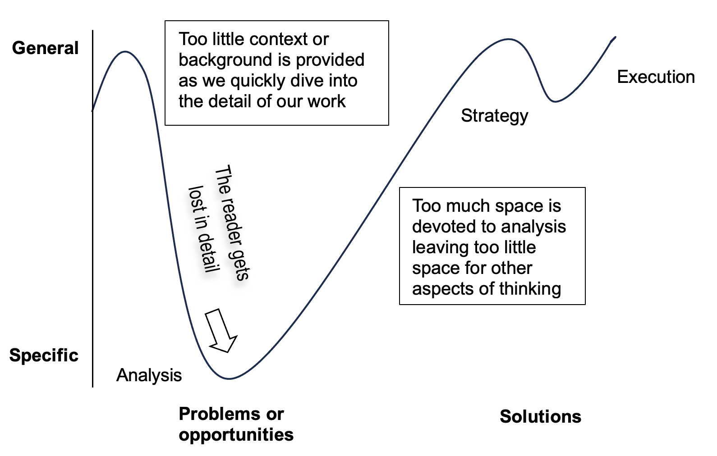
Beware paralysis by analysis

Slide 25
Overview
The purpose of our documents
Our audience and the curse of knowledge
Distinguishing content and method
How we arrange content
Method – how we go about writing

Slide 26
Beware 90% complete but 50% to go
Misjudging the allocation and use of time in producing our documents
Engineers example
Method compromised the report
Imbalanced – 98 pages of data
No recommendations were made

Slide 27
Beware 90% complete but 50% to go
Some observations about this method.
It followed a linear sequence – the engineers waited to write.
Their method suggested that their understanding of the story should occupy most of the time (88%).
The method allowed too much time for understanding the issues and not enough time for formulating solutions and recommendations.
The method resulted in an ‘imbalanced’ report with too much data and analytical information. In effect, the majority of their report should have been an appendix.
Their allocation of time required them to get the report ‘right the first time’. They did not allow time for significant re-words (e.g. review, rewrite, revise).

Slide 28
Activity
Construct a list below of what we need to allow time for in the development of our content and in the production of our document?

Slide 29
Rethinking our use of time
It is a myth to expect to get the document right the first time
“Actually, the essence of the process is revision.” Source: John McPhee, Draft No. 4
“Re-Writing is the essence of writing well.” Source: William Zinsser, On Writing Well
Replace linear sequencing with concurrency and don’t wait to write
Be explicit about the time required to produce a final document, in particular for the time needed for all the ‘re-‘ words (e.g. reword, rewrite, revise).

Slide 30
Initiate a mid point review
Force the 50% to go mark of the work – create volume and form a view
Test your narrative, insights and report outline at the mid point
After that point try to write what you know
”…show a draft to some people who are similar to our intended audience and find out whether they can follow it. ……Only when we ask those people do we discover that what's obvious to us isn't obvious to them.” Source: Stephen Pinker pg75

Slide 31
Author as project manager
Tasks that require time

Slide 32
First (your) draft – Second (their) draft – Third (quality) draft

Slide 33
No time for writer’s block
Writer’s block is largely due to premature perfection
Allow time to write imperfectly and correct later
Write in sections, write what you know early
Free the mind - do not delete information – reallocate it
The information we have gathered can end up in one of three places:
In our final document
In an appendix or attached to the document
In a ‘discard’ file that we establish to capture writing we no longer require.

Slide 34
Editing Activity
“One of the best things you can do for yourself to improve your writing is to learn how to cut out words that are not necessary.”
Can you reduce this sentence to seven words or less?

Slide 35
Editing
“Re-Writing is the essence of writing well.”
“We all have an emotional equity in our first draft; we can’t believe that it wasn’t born perfect. But the odds are close to 100% but it wasn’t. Most writers don’t initially say what they want to say, or say it as well as they could. The newly hatched sentence almost always have something wrong with it.”
Source: William Zinsser

Slide 36
Editing
Editing work can be broadly categorised into the following three tasks:
Substantive (or structural) editing – assessing the document as a whole for its content, structure, language and presentation.
Copy editing – More detailed editing for accuracy and consistency in language, style and layout
Proofreading – final checking to ensure the document is ready to send.
Source: Style Manual, Australian Government – Chapter 14.
Our ability to edit will be a function of:
Our understanding of the styles and standards required
the time we have allowed to it and
our eye and ear for detail in finding errors.

Slide 37
Style guide
The Department for Education Writing Style Guide contains sections on:
Key principles
Our style
Writing for or about:
Aboriginal people
people with a disability
young people in care.
Common words and phrases
Quick tips
Editing checklist

Slide 38
Style Guide
The guide includes detailed advice under the following headings:
Key principles | Our Style
Tone | Abbreviations and acronyms | Gender-neutral content | Referencing
User-focused content | Alignment | Headings and structure | Sentence form
Spelling | Bias free | Job titles and positions | Single spacing
Plain language | Australian vs American English | Numbers | School terms and year level
Active voice | Bullet points and lists | Punctuation | Times and dates
Minimal capitalisation and punctuation | Capital letters | Positive voice | Underline or italics
Adaptability | Dashes and Hyphens | Quotation Marks | Upper case

Slide 39
Allow time to summarise
Summarisation is a function of method and choice.
Summarise our writing
“I didn't have time to write you a short letter, so I wrote you a long one.” Mark Twain
“Perfection is achieved not when there is nothing more to add, but when there is nothing left to take away” Antoine de Saint Exupery.
PRAISE can be used as a structure for an executive summary

Slide 41
Narrative
“Narrative is the choice of which events to relate and in what order to relate them – so it is a representation or specific manifestation of the story, rather than the story itself.”
What makes a good story/good narrative?
Unresolved tension or conflict
Resolution and the promise of an ever after
The reader/decision-maker is involved in the story.

Slide 42
Choices
Choices about the type of story we want to tell.
Choices about what to include and exclude.
Choices about how to sequence information (structure and balance).
Choices about how to summarise, consolidate and prioritise data.
Choices about whether to use tables or graphs in our presentation of data.
Choices about which graphs to use in our presentation of data.
Choices about how we use our time in the preparation of our document.

Slide 43
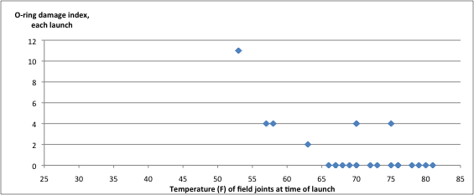
Present numbers to reveal patterns

Slide 44
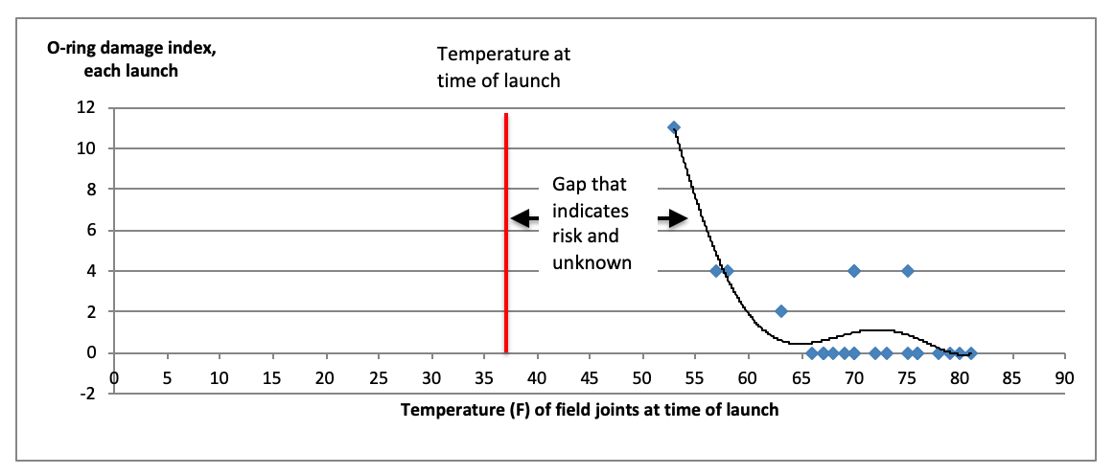
Present numbers to reveal gaps

Slide 45
Present numbers to build a story
Recent History/Trends
Gap in no change
What change is needed

Slide 46

WRITE A BEAUTIFUL QUOTE HERE TO
ENGAGE YOUR AUDIENCE

Slide 47
Include text here

Slide 48
Include text here

Slide 49
SUPPORTING THE
PUBLIC SECTOR
Include text here

Slide 50
Include text here

Slide 51
Thank you for attending
51

